Slide 1
Angiosperms (estimated 257,400 angiosperm species in 13,678 genera)
Basal Angiosperms: The ANITA Grade
(Amborella, Nymphaeales, Illiciaceae, Trimeniaceae and Austrobaileyaceae)
Judd et al pp. 225-236

Slide 2
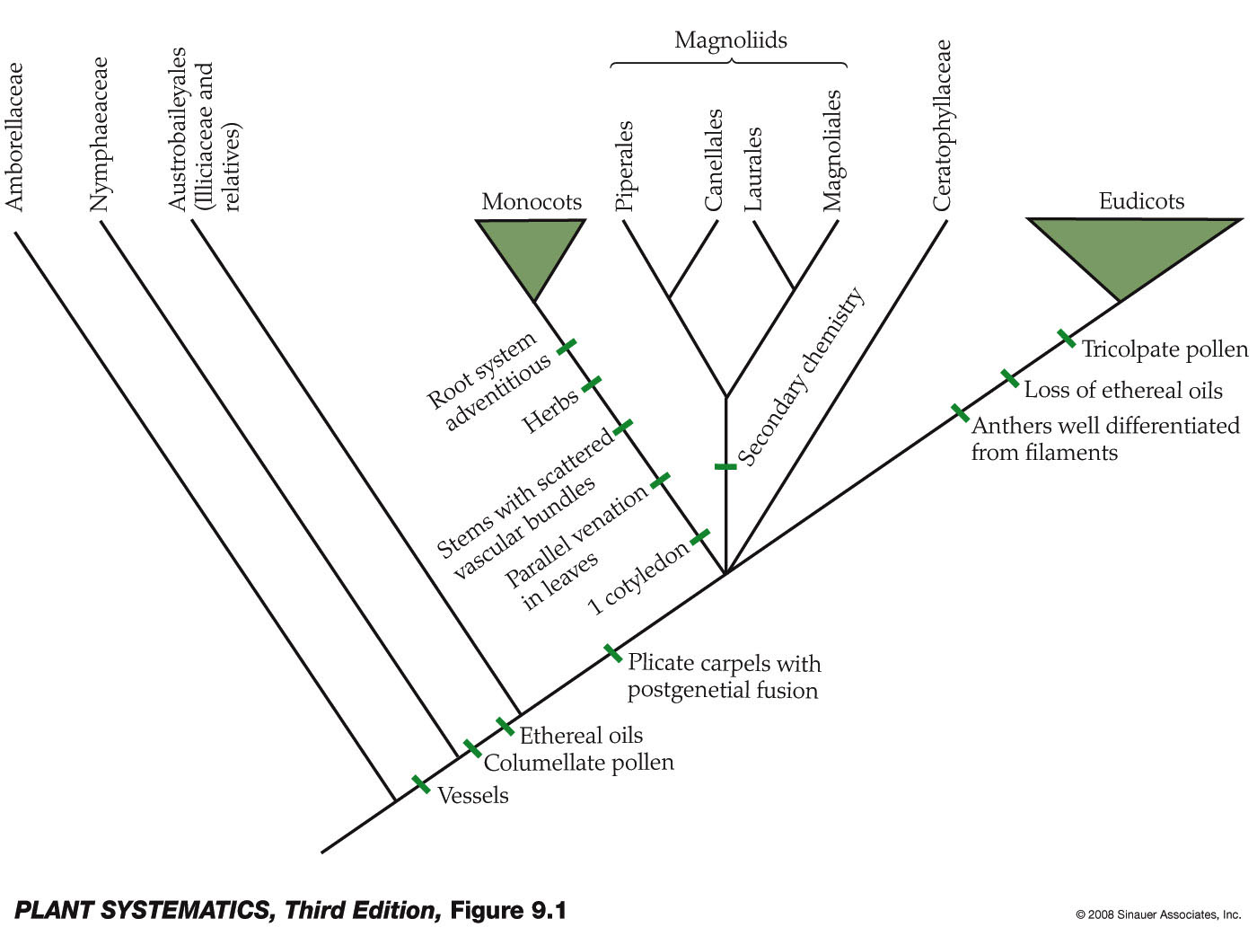
ANITA Grade

Slide 3
HYPOTHETICAL ANGIOSPERM PHYLOGENY
A
B
C
D
E
F
?

Slide 5
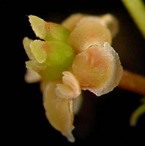
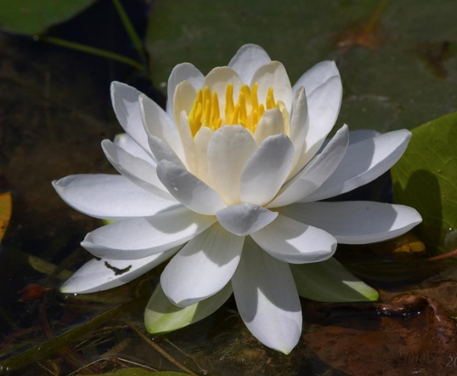
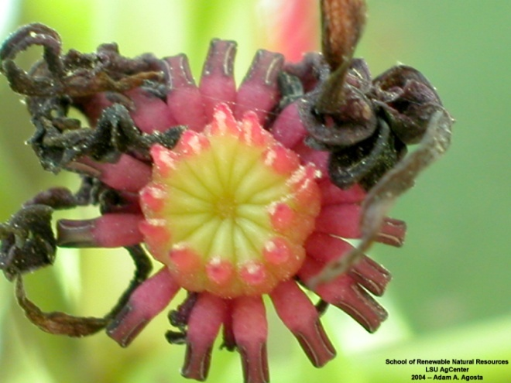
“ANITA GRADE”

Slide 6
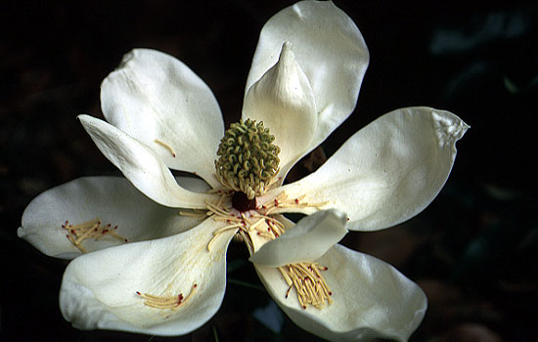
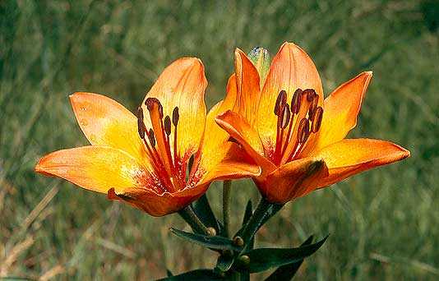
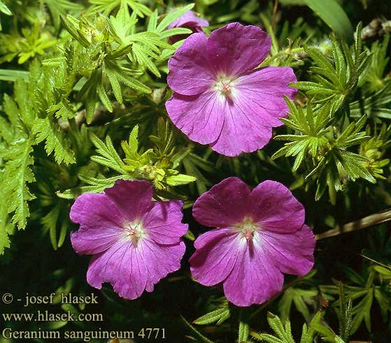
Magnoliids
Monocots
Eudicots

Slide 7
Angiosperm Synapomorphies
Seeds produced within a carpel with a stigmatic surface for pollen germination
Very reduced female gametophyte, consisting in most cases of just 8 nuclei in seven cells
Double fertilization
Triploid endosperm
Specialized phloem (companion cells derived from same mother cell as sieve tube elements)– though very similar to gymnosperms. Gymnosperms have sieve pores, while angiosperms have sieve plates.

Slide 8
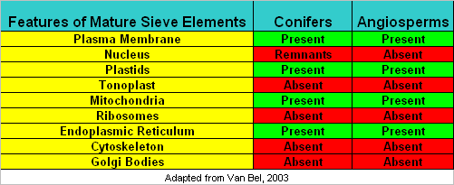
Sieve Elements
Sieve cells are living (metabolically active), but dependent on the companion cells . “Sieve elements” refers either to sieve tube member (angiosperms) or sieve cell (gymnosperms and ferns.)

Slide 9
Angiosperm Synapomorphies
Vessels in xylem tissue (not just tracheids; this feature probably evolved within the group however)
Many molecular features as well.

Slide 10
Generalized Flower Parts

Slide 11
Angiosperm Life Cycle
Gametophyte of non-ANITA grade angiosperms usually has 8 cells.

Slide 12
Flowers of Early Angiosperms (as judged by the ANITA Grade)
Insect pollinated
Radially symmetrical
Perfect (bisexual, although not Amborella) and hypogynous
Parts several to numerous
Parts free and distinct
Perianth poorly differentiated into calyx and corolla (i.e., with tepals)
Stamens poorly differentiated into anthers and filaments

Slide 13
Flowers of Early Angiosperms (as judged by the ANITA Grade)
Pollen grains monosulcate
Carpels with poorly differentiated stigma and style
Carpel margins sealed by a secretion rather than fusion of epidermal layers as in other angiosperms.
Female gametophyte may have unusual numbers of cells and ploidy level of endosperm: most other angiosperms have an 8-nucleate female gametophyte and triploid endosperm

Slide 14
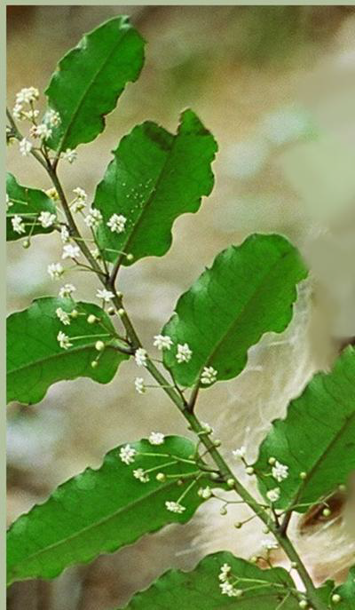
Amborella trichopoda

Slide 15
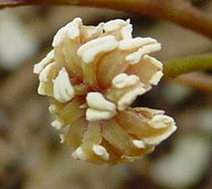
Amborella trichopoda: flower
Lacks vessels
9-nucleate female gametophyte and triploid endosperm
Shrub
Stigma and style poorly differentiated
Flowers unisexual, carpellate flowers have sterile stamens
(staminodes)
Tepals= no differentiation into sepals and petals
Stamens poorly delimited
between anther and filament
(filament short); inner
stamens frequently sterile
(staminodes)

Slide 16
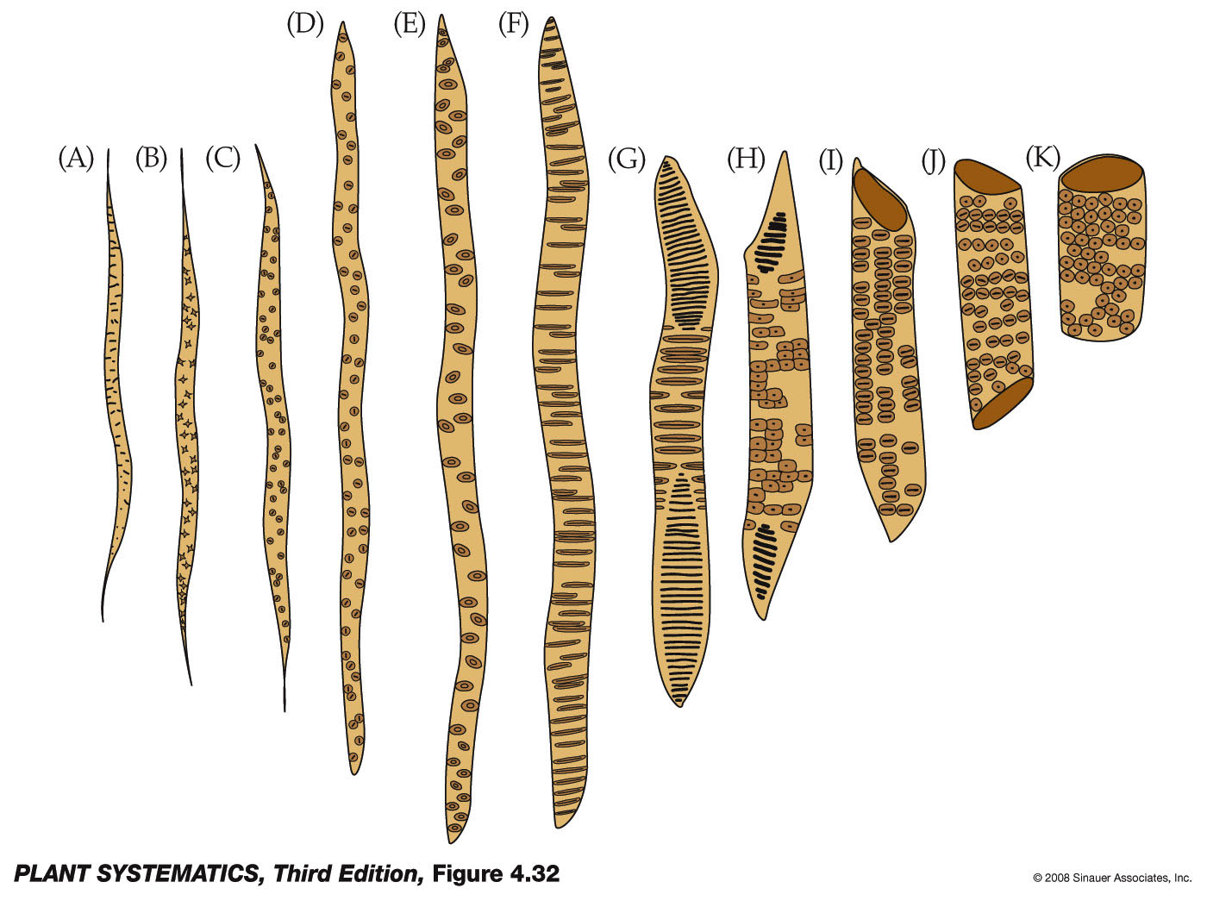
Amborella trichopoda
Vessel elements NO!
Tracheids yes!

Slide 17
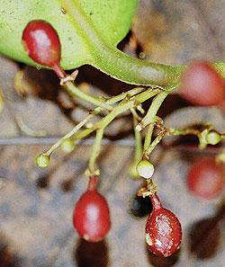
Amborella trichopoda: other distinctive features
Fruit (Yes, our first plant with a fruit!!) is an ovoid red drupe
“More or less inaperturate pollen” J&C pg. 233
Both insect and wind pollinated
Drupes are dispersed by birds

Slide 18
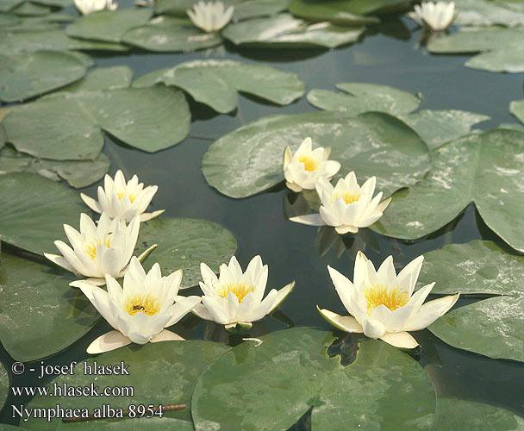
Nymphaceae: Water Lillies

Slide 19
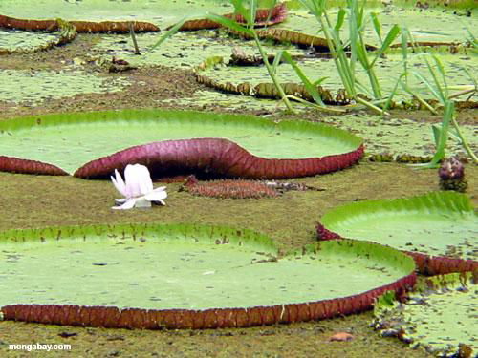

Slide 20
Nymphaceae: Water Lillies
Either lack vessels or have intermediate tracheid-like vessel.
Tepals
Stems with conspicuous air canals
Aquatic
Tepals seem to intergrade with stamens
Stamens sometimes poorly differentiated into anther and filament

Slide 21
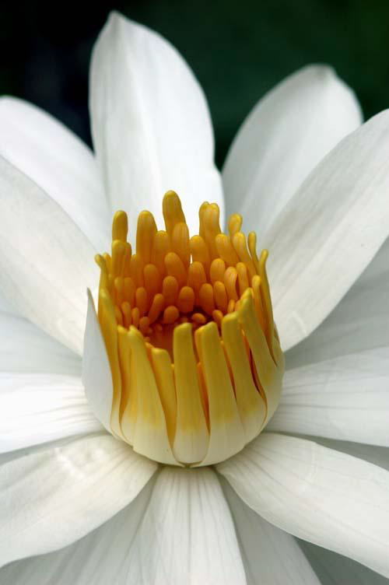
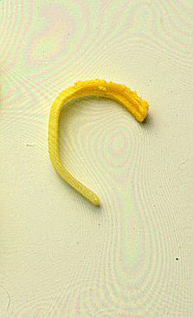
Stamens
Stamen poorly differentiated into filament and anther
Petals seem to intergrade into stamens

Slide 22
Nymphaceae: Water Lillies
Pollen grains usually monosulcate
Carpels distinct or connate
Some flowers attract beetles by producing heat (!) along with a strong fruity odor, flowers opening and closing daily to trap the beetles
4 cell/4 nucleus female gametophyte and diploid endosperm!

Slide 23
Nymphaceae: Nymphaea odorata
(F-H) Petal-like stamens
(E) Petal
Petals seem to intergrade into stamens

Slide 24
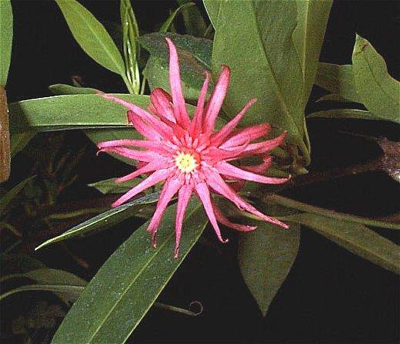
Austrobaileyales (Star Anise Family) (includes Illiciaceae, Austrobaileyaceae and Trimeniacae
Illicium

Slide 25
Illiciaceae
Stamens still poorly differentiated into filament and anther
Vessel elements clearly present
Tepals still present
Fruit a star-like aggregate of 1-seeded follicles
Endosperm diploid
Pollen grains with 3 (or 6) furrows!! -- a feature that leads to the Eudicot clade

Slide 26
Illiciaceae
Poorly differentiated stamens
Poorly differentiated stigma and style

Slide 27
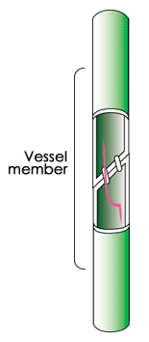
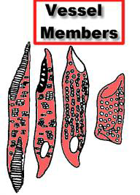
Vessel Members Clearly Present

Slide 28
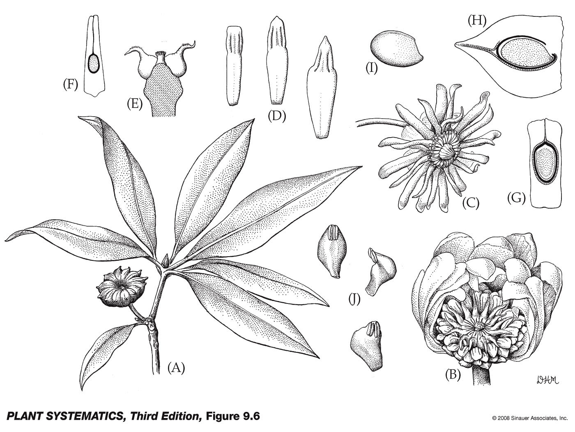
Petaloid stamens

Slide 29
Next stop!!!!!
You are here!

