Slide 1
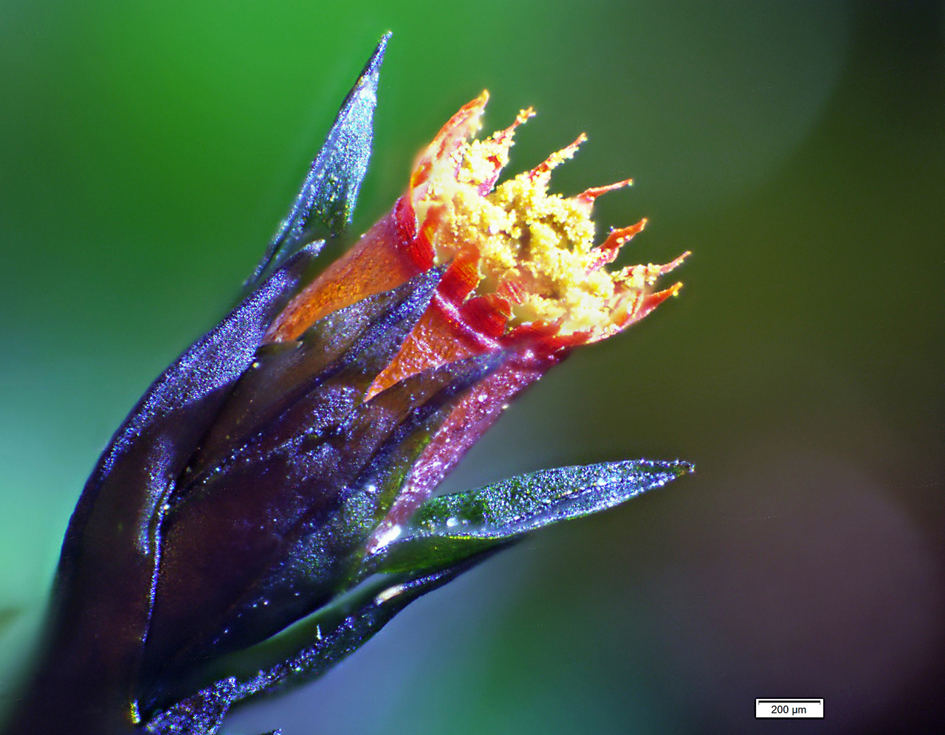
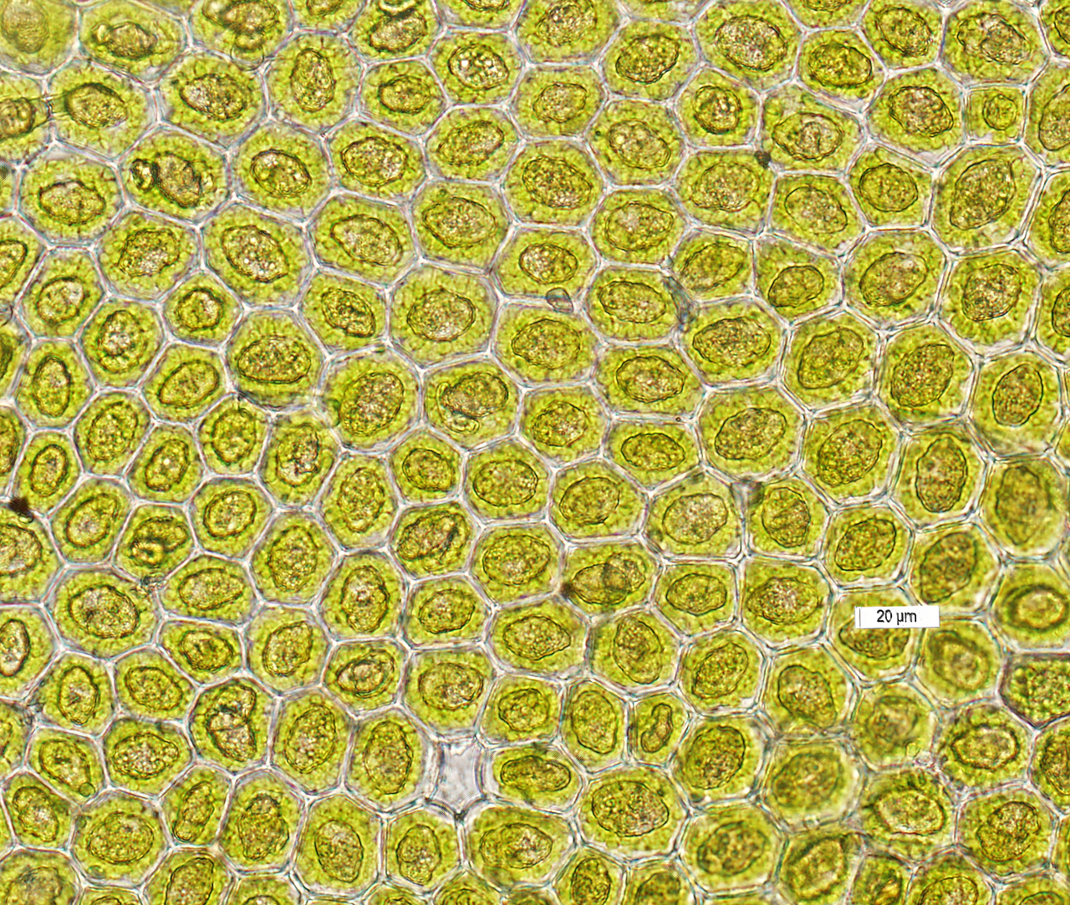
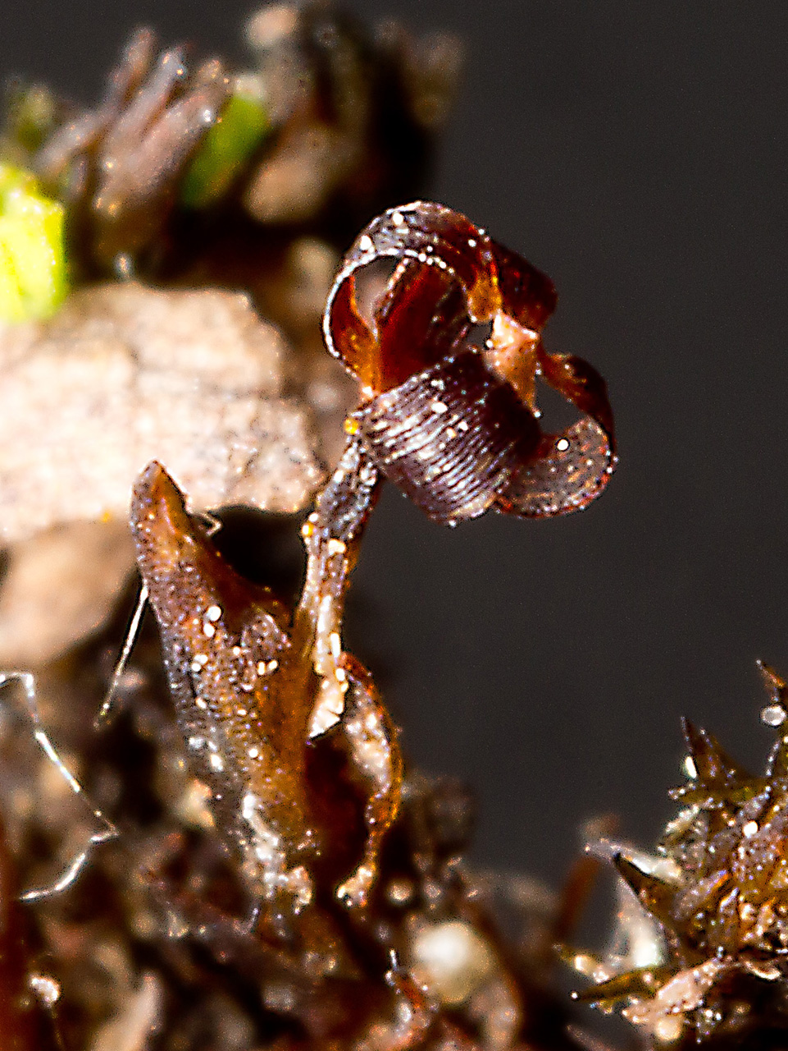
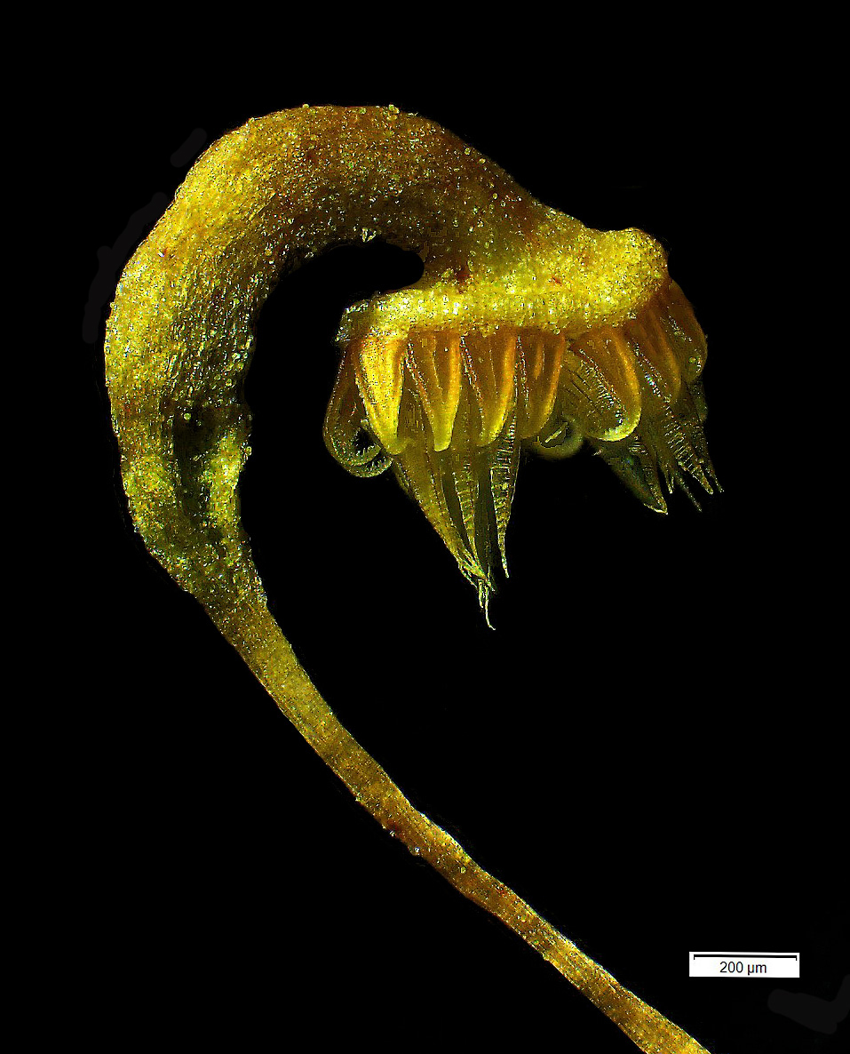
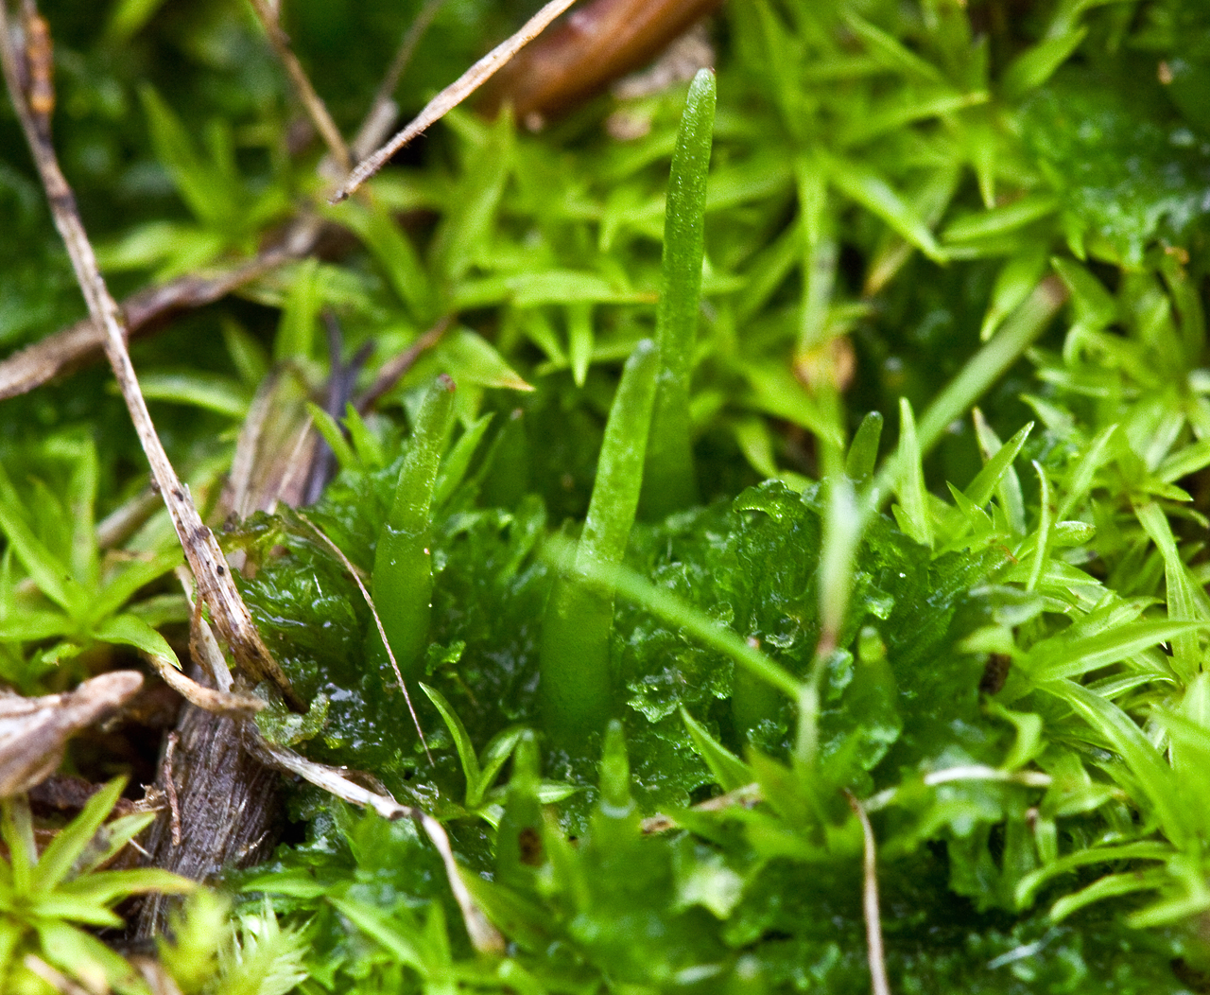
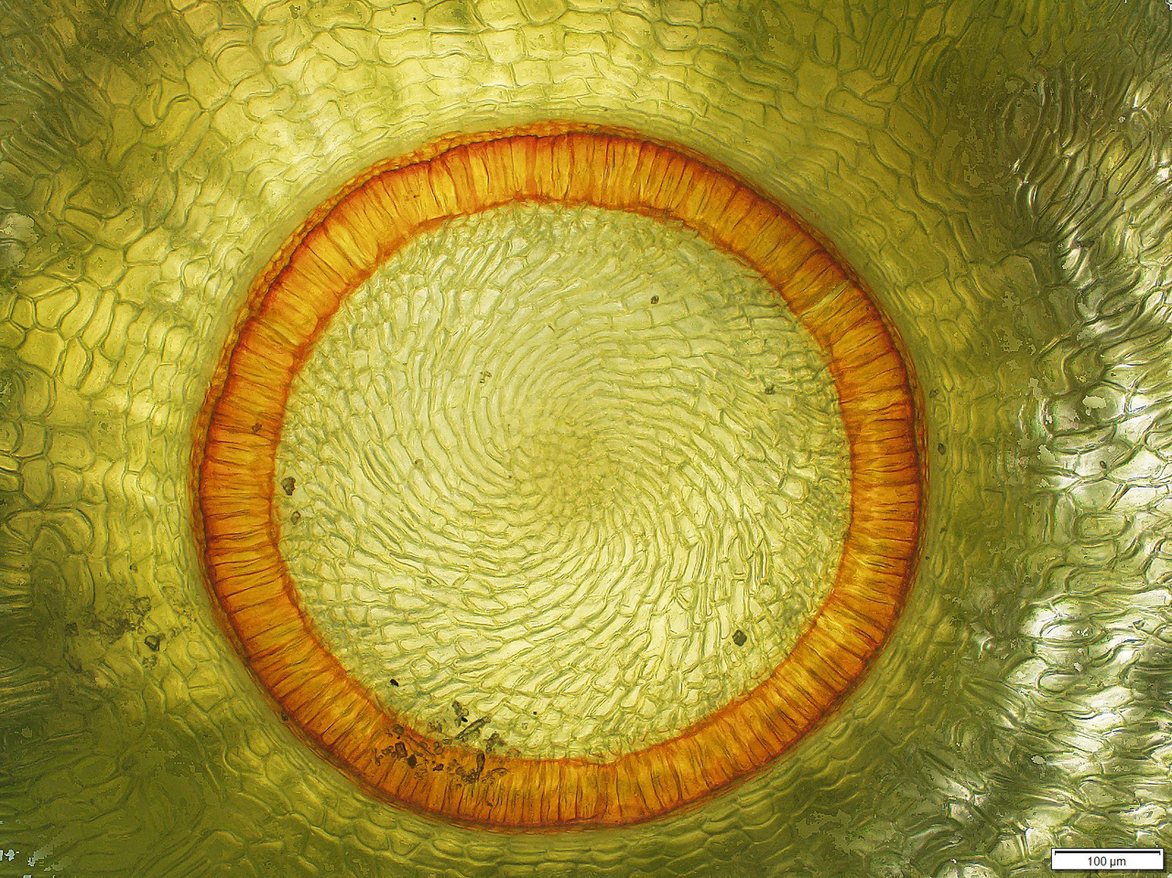
“Bryophytes”
Liverworts, Mosses, & Hornworts

Slide 2
A Phylogenetic Problem
Scanty early fossil remains
First embryophyte (land plant) lineages
Liverworts probably appeared over 450 million years ago

Slide 3
Most Likely Scenarios
Transition to land

Slide 4
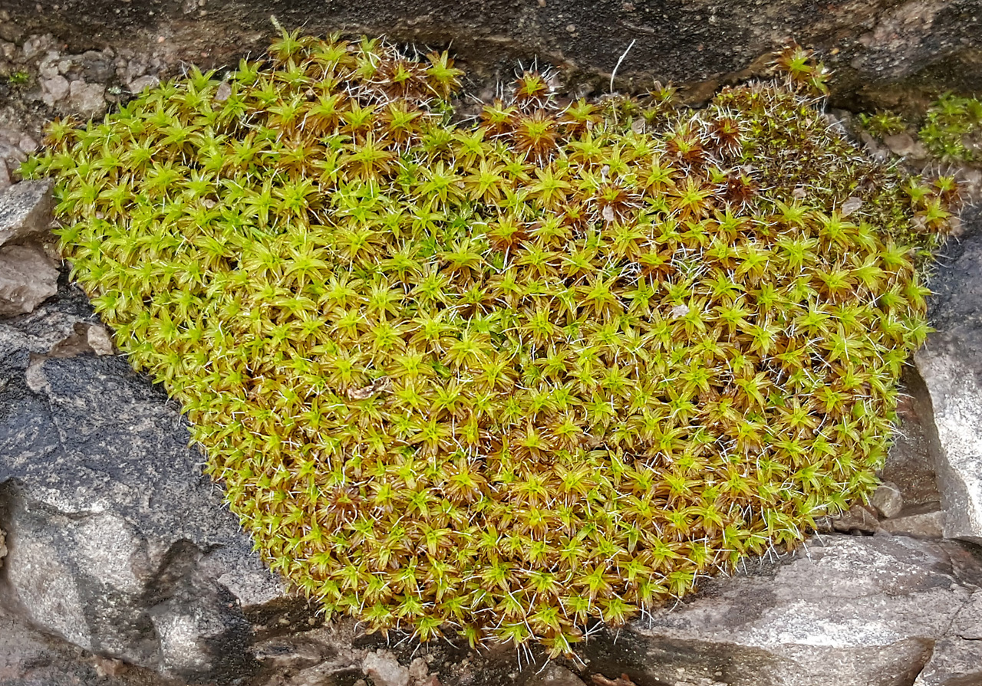
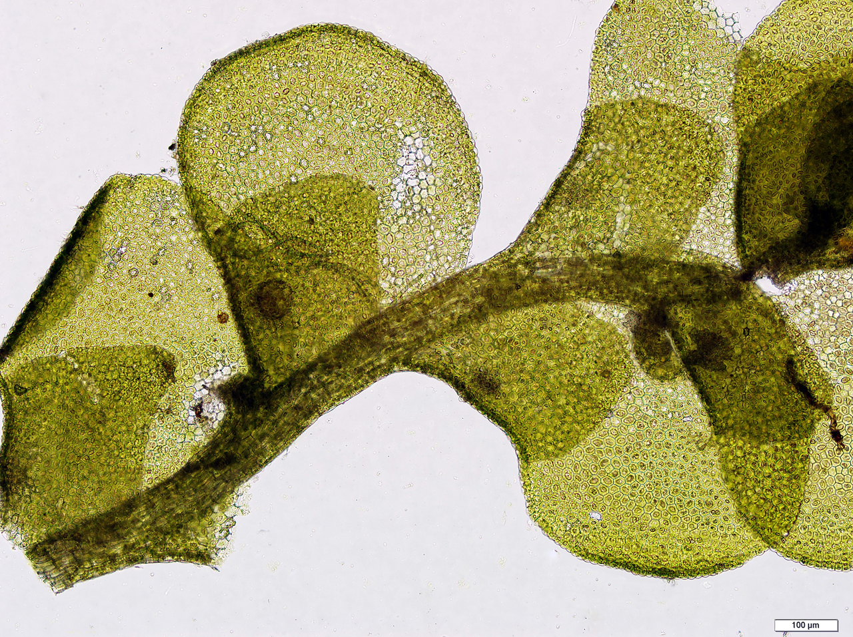
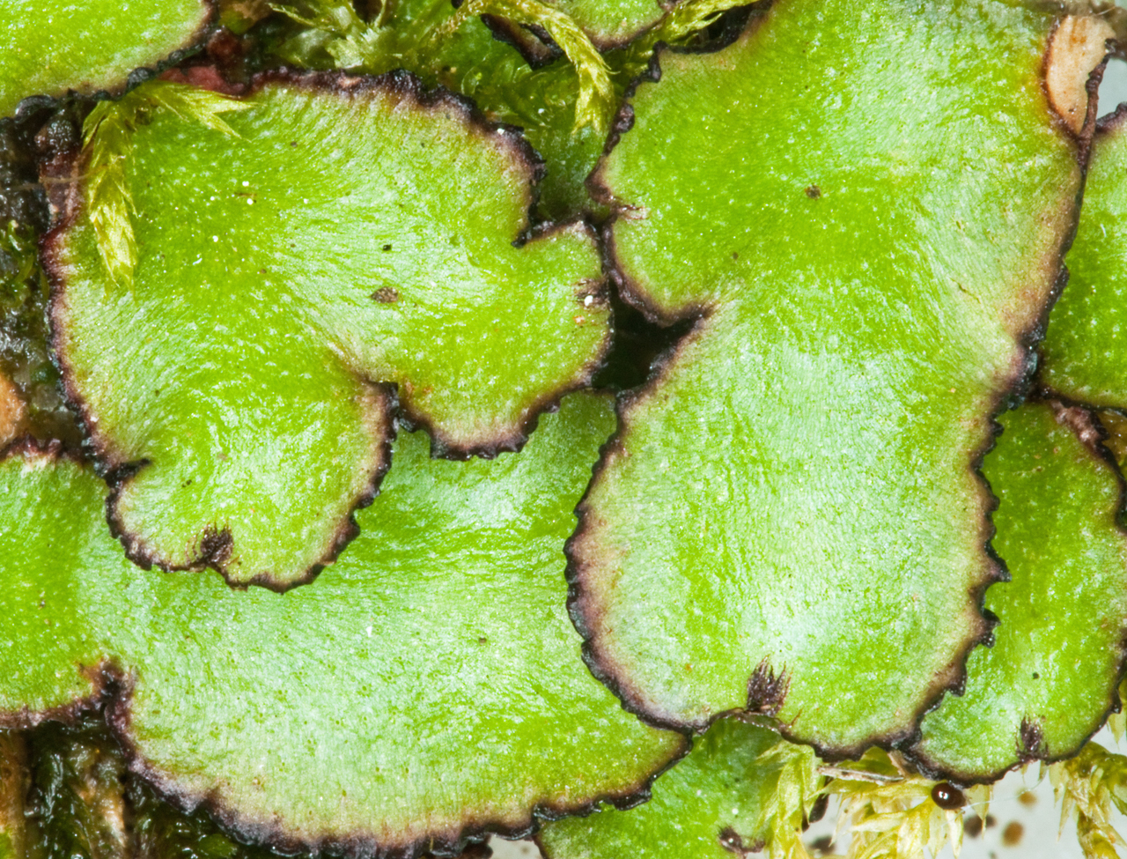
What do they look like?
Hornworts
Mosses
Liverworts
Syntrichia ruralis
Radula complanata & Reboulia haemispherica
ID depends on mature spores, etc.

Slide 5
“Bryophytes”
Each of the three lineages has its own set of synapomorphies
Most “bryophytes” are less than about 10 cm tall
All have multicellular sporophytes→ alternation of generations
(some algae have a diploid stage, but not multicellular (embryo) so no
alternation of generations).
None have lignin– a complex chemical that imparts structural strength needed for taller plant growth
All have embryo, gametangia, sporangium, cuticle (i.e., are embryophytes, land plants)

Slide 6
“Bryophytes”
Green plants, so they possess chorophylls A & B, starch, cellulose
Sporophyte is short lived to annual, always attached and at least partially dependent on the gametophyte
Sporophyte is unbranched with a single terminal sporangium
The gametophyte is perennial and usually has a filamentous juvenile phase
Male gametes are biflagellate (whiplash) and must reach egg through a water film. Female sex organ (archegonium) is flask shaped and encloses a single egg
Growth of the gametophyte is by a single apical cell and not by meristematic tissue

Slide 7
Mosses

Slide 8
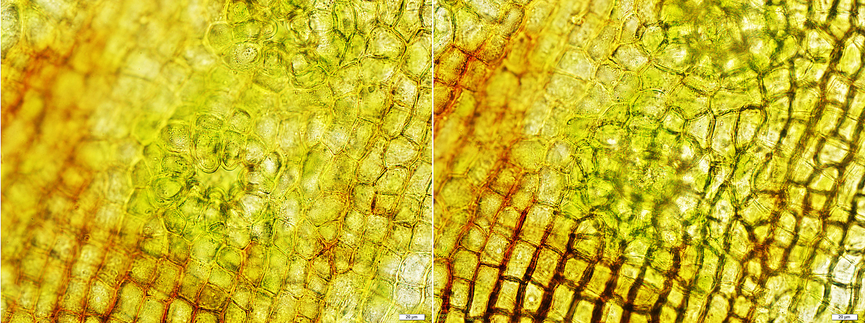
Moss synapomorpy– Stomata (but only in sporangium wall)
Immersed
Superficial

Slide 9
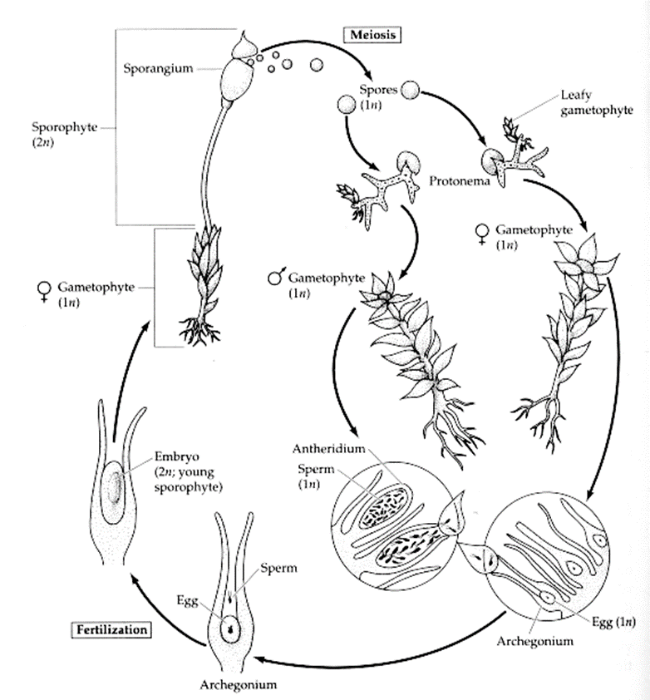
The Moss Life Cycle

Slide 10
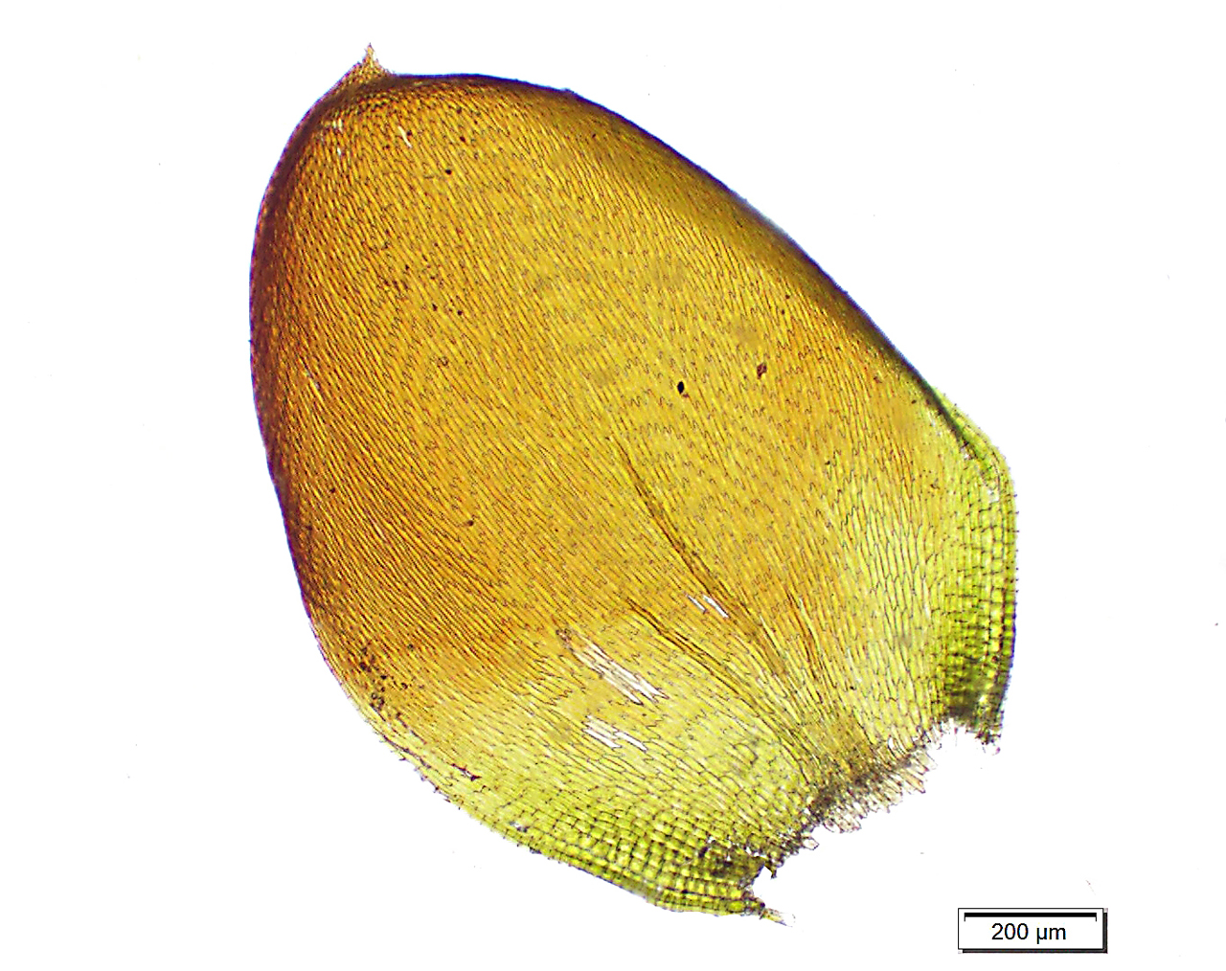
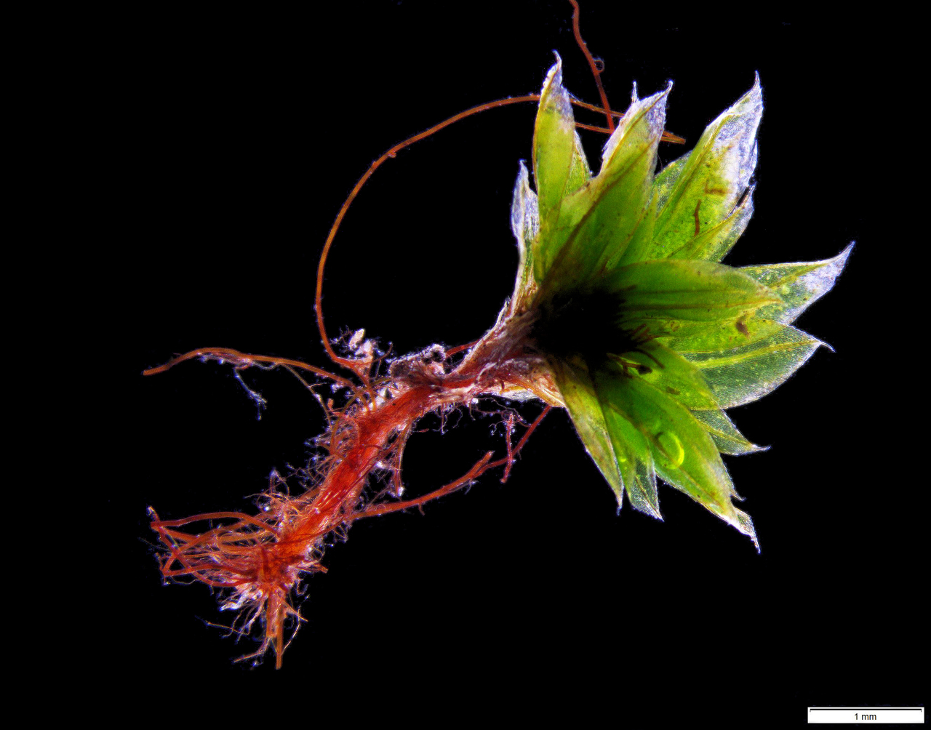
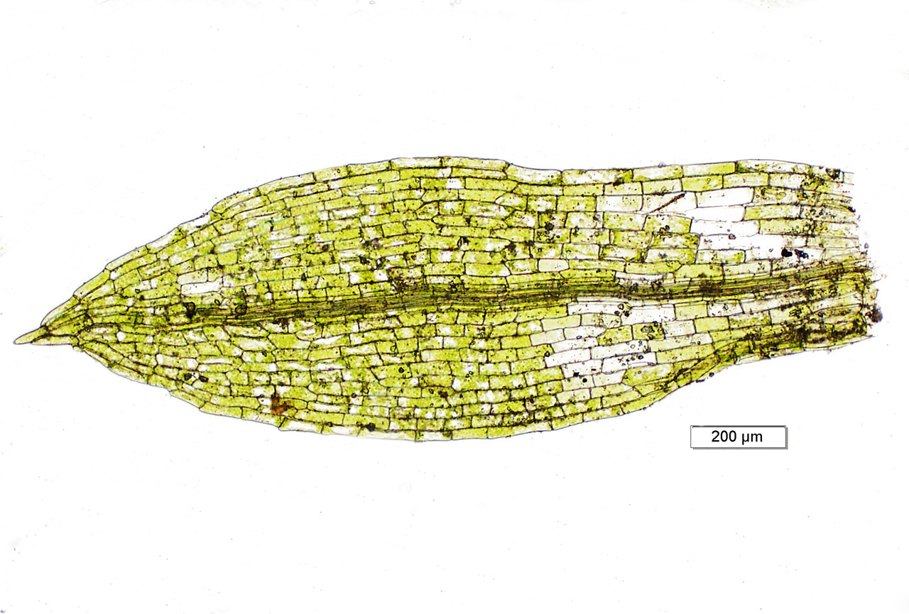
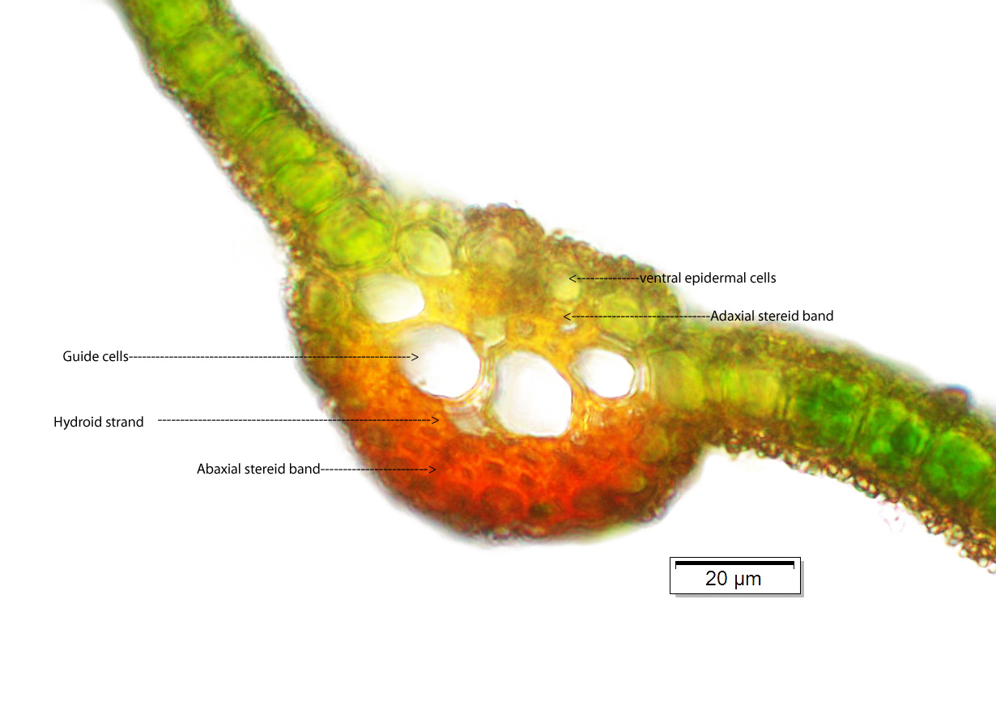
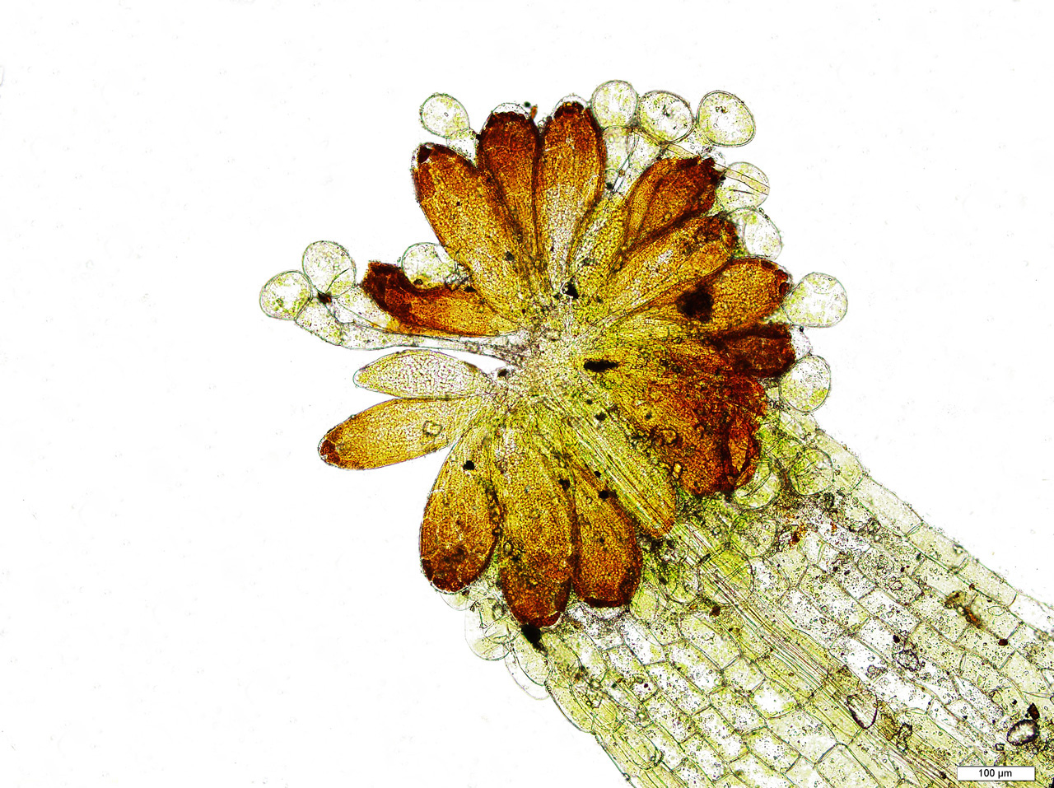
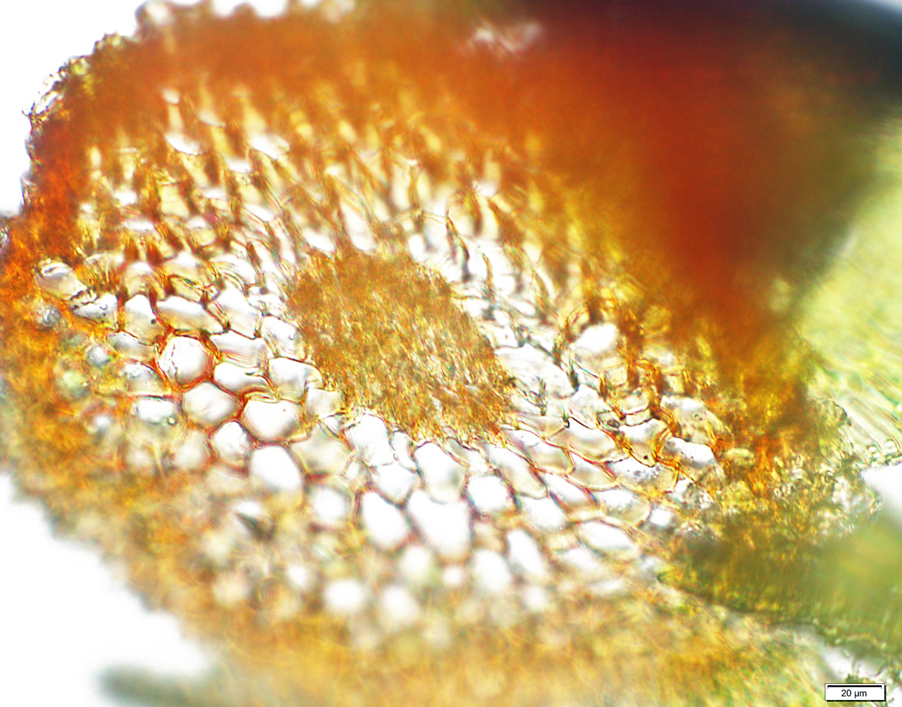
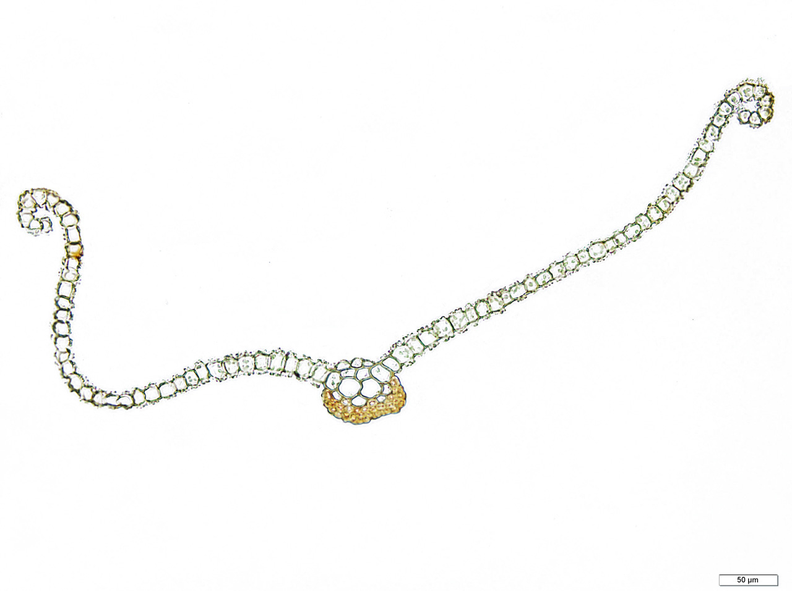
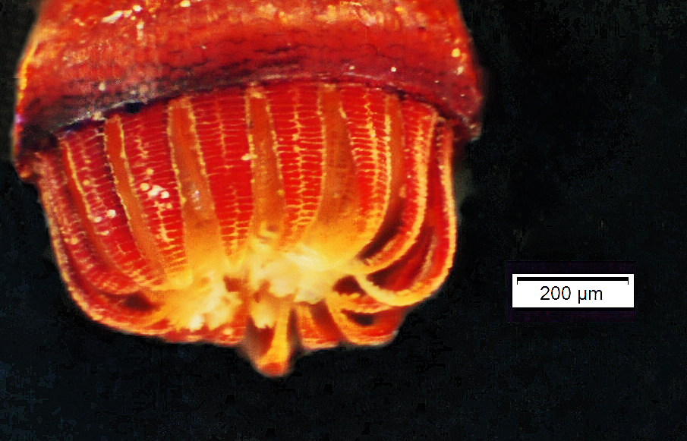
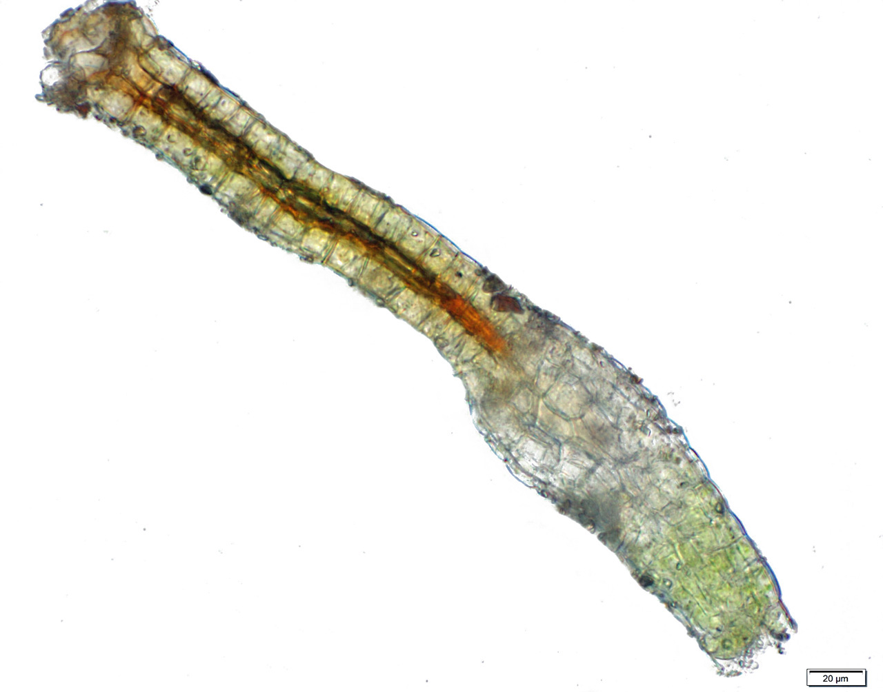
Moss Anatomy
Rhizoids
Antheridia with paraphyses
Leaves mostly unistratose
Archegonium
Peristome

Slide 11
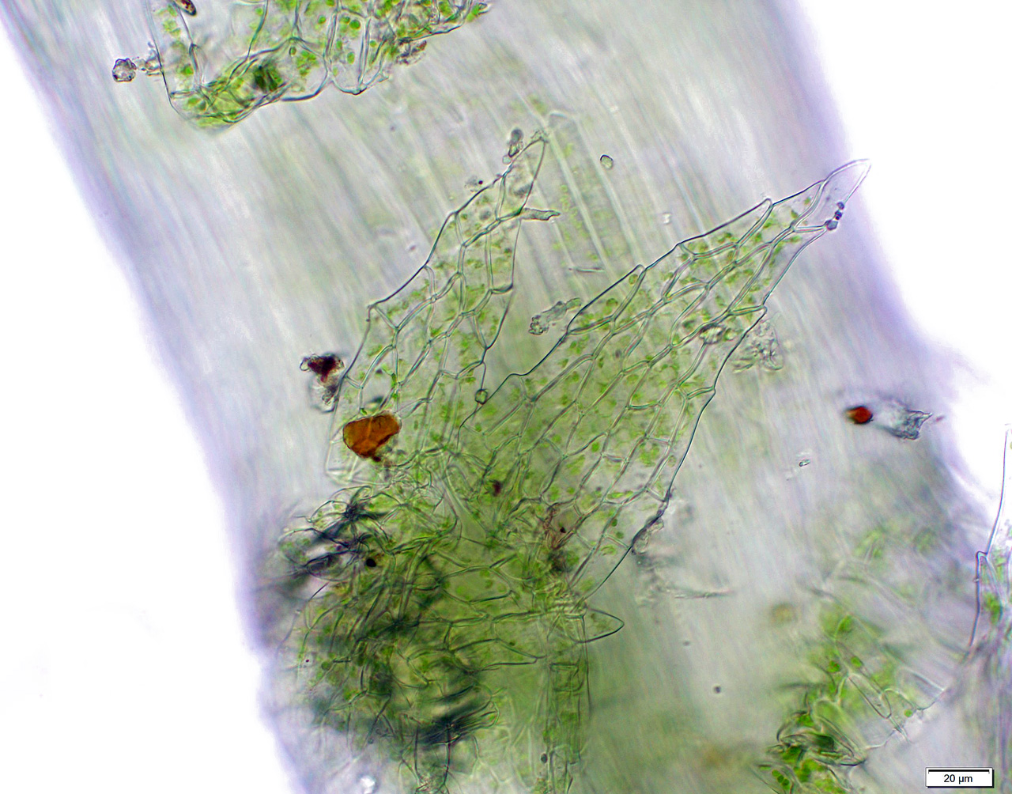
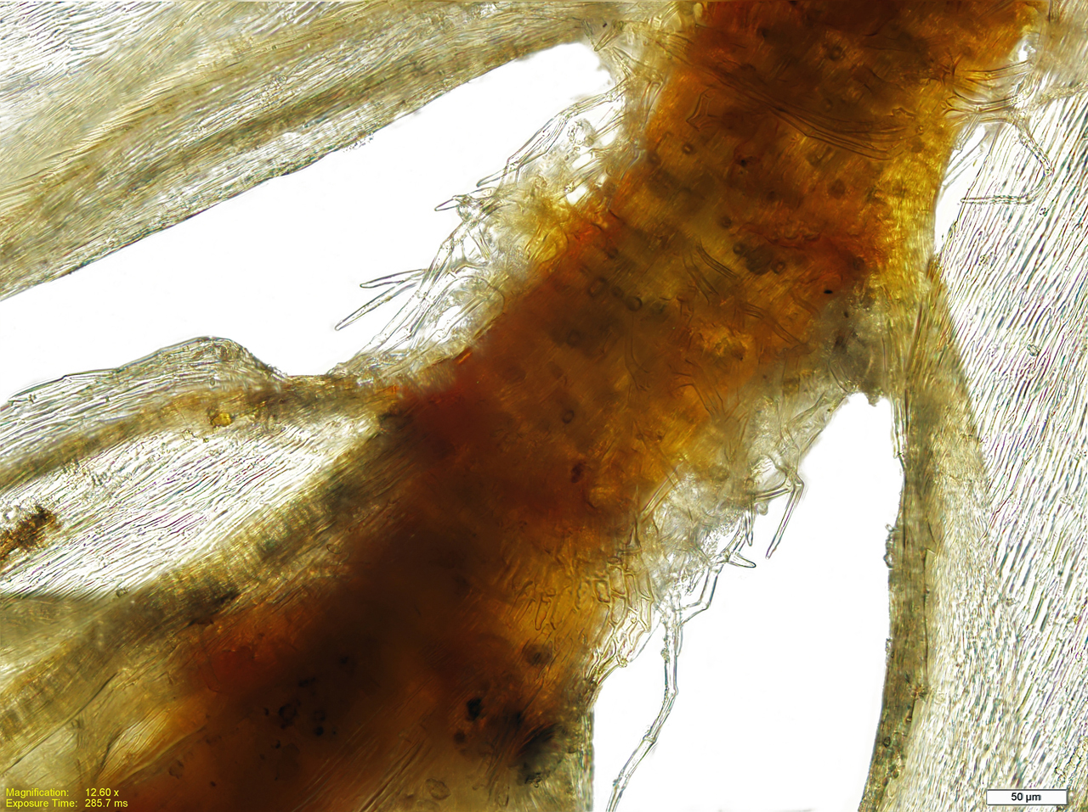
Moss Anatomy
Mosses possess leaves that are usually one cell thick
The leaves may have an oval midvein that is several cells thick
Mosses have stems that may have external decorations for protection of buds and for water conduction by capillary action (paraphyllia & pseudoparaphyllia) and sometimes contain internal conducting tissue (hydroids & leptoids)

Slide 12
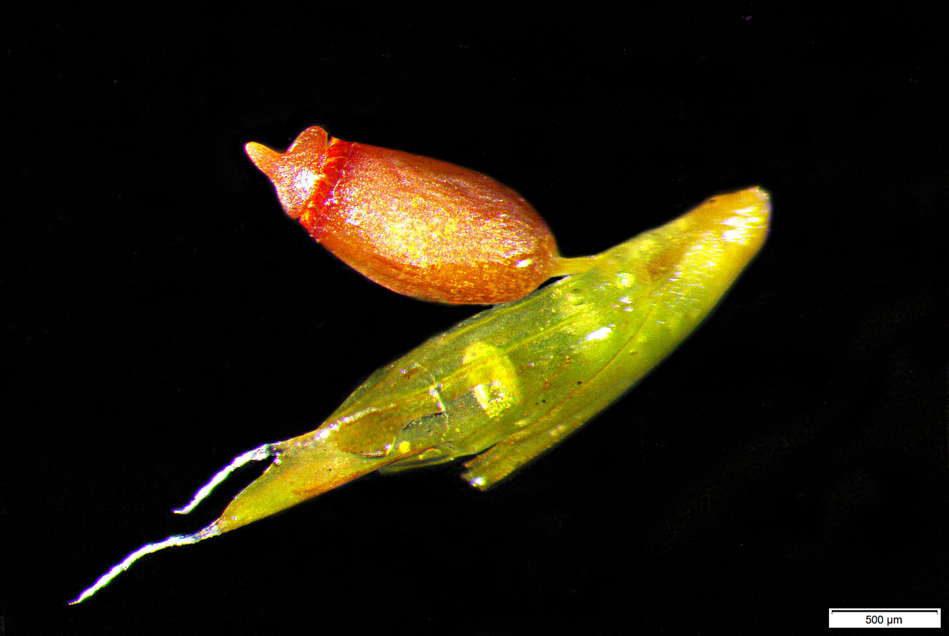
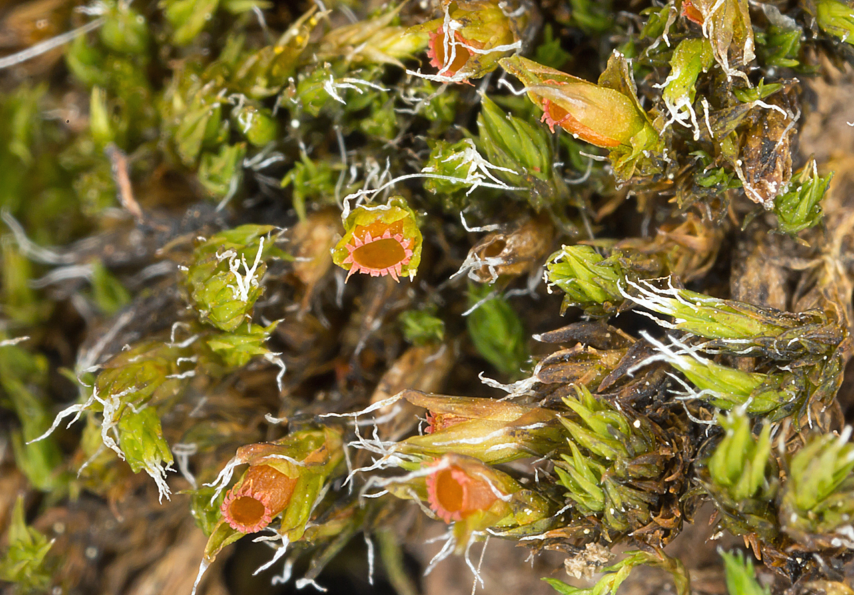
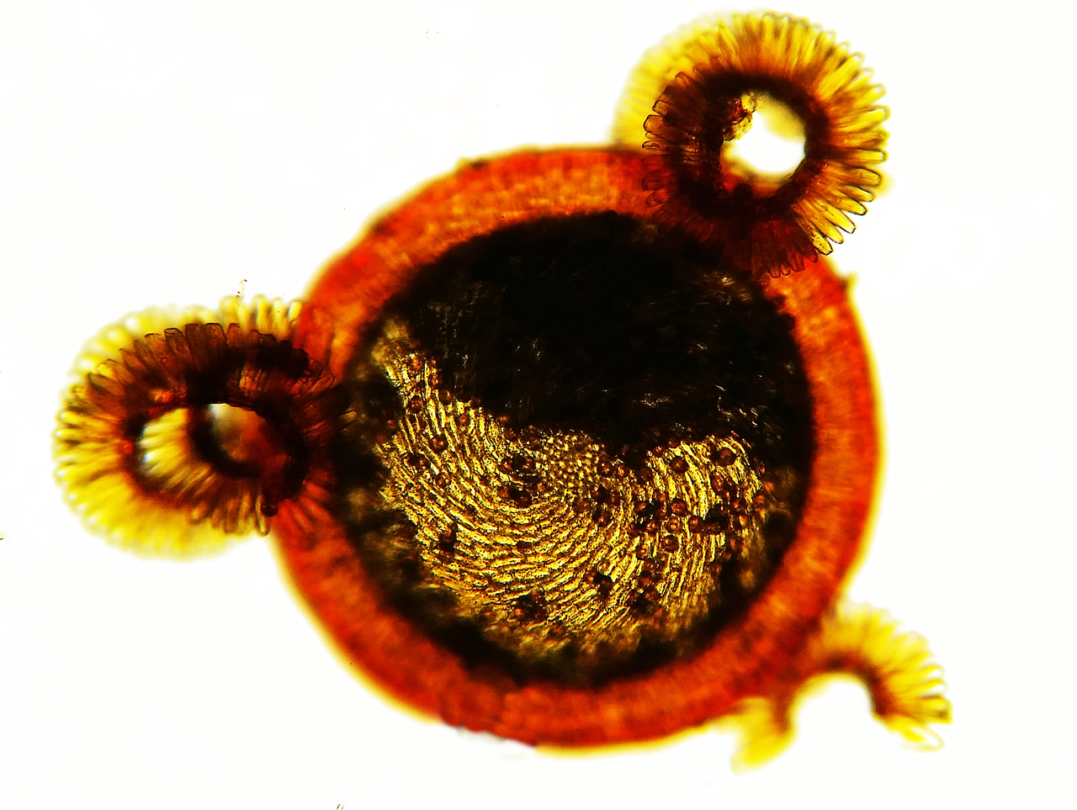
The Moss Sporophyte
The calyptra is gametophyte tissue, the operculum is sporophyte tissue.
The operculum separates at the annulus
Immersed sporophytes

Slide 13
Some Mosses Have No Peristome (eperistomate)
Takakia
Andreaea
Image: Ken McFarland

Slide 14
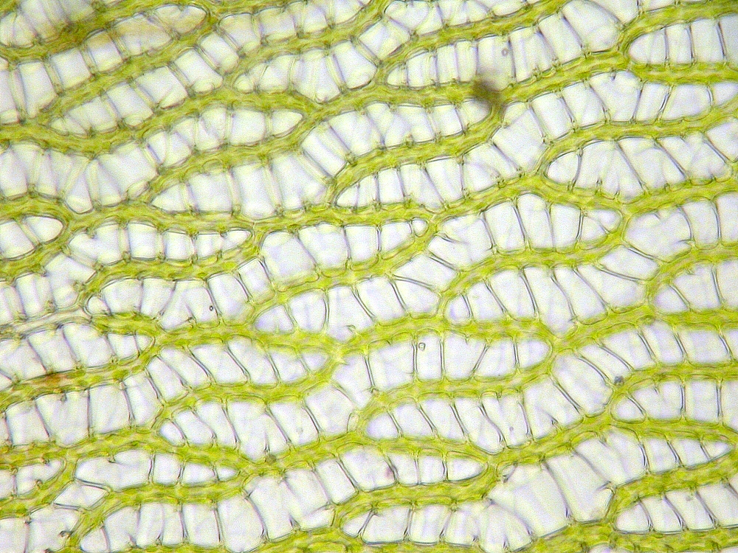
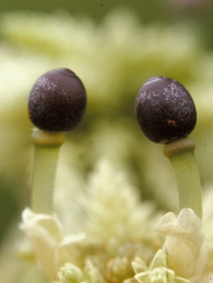
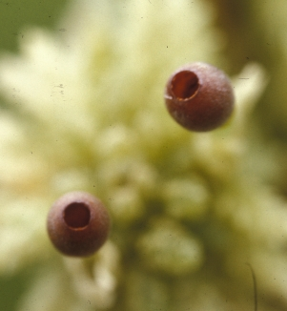
The genus Sphagnum is a special case… Highly absorbent dead hyaline leaf cells between live chlorophyllose cells→
From Schofield, Introduction to Bryology 1985– “Spore dispersal in Sphagnum is unlike that of any other moss. As the mature subspherical sporangium dries out, it shrinks in diameter and the columella collapses and is replaced by gaseous material. The shrinking sporangium places the gas under considerable pressure (up to 5 atmospheres, or equivalent to the air pressure in large tires of trucks of intermediate truck-trailer size). This pressure against the operculum forces it to be thrown off violently, and the spores are shot into the air…”

Slide 15
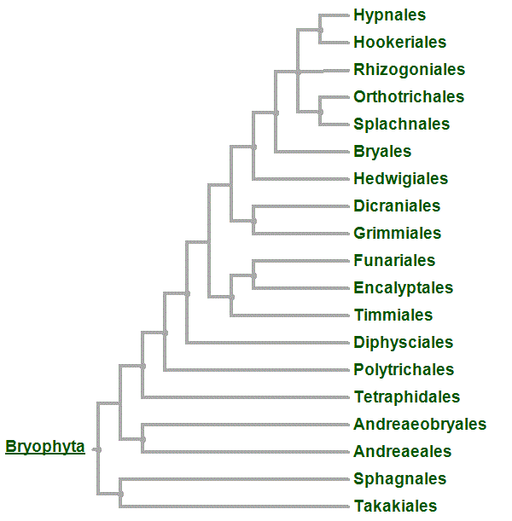
Takakia, Sphagnum and Andeaea are early diverging lineages

Slide 16
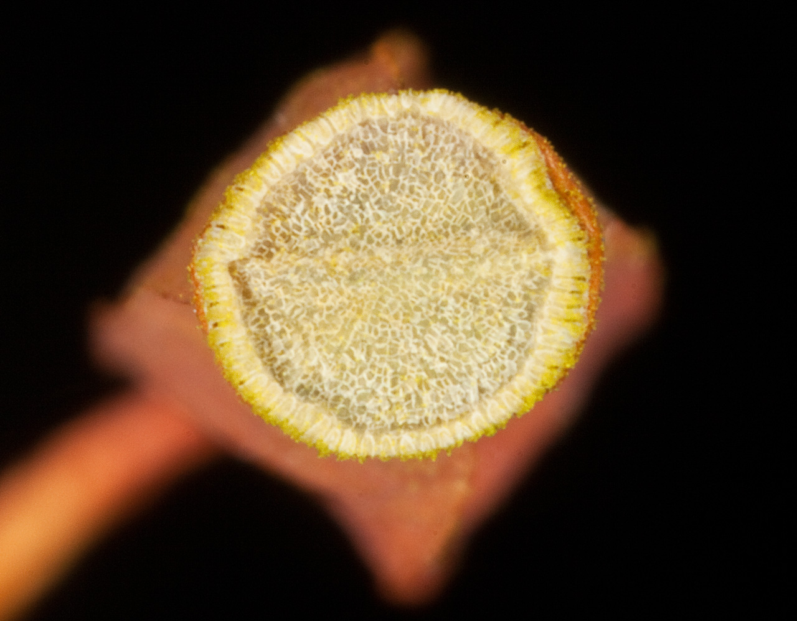
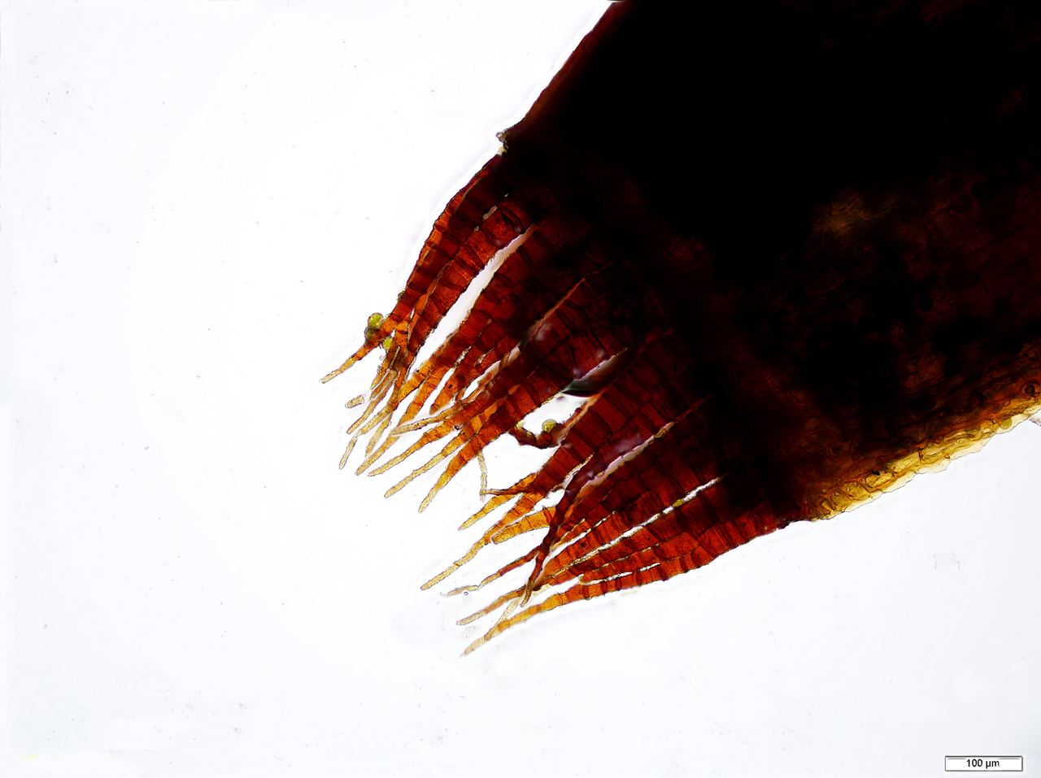
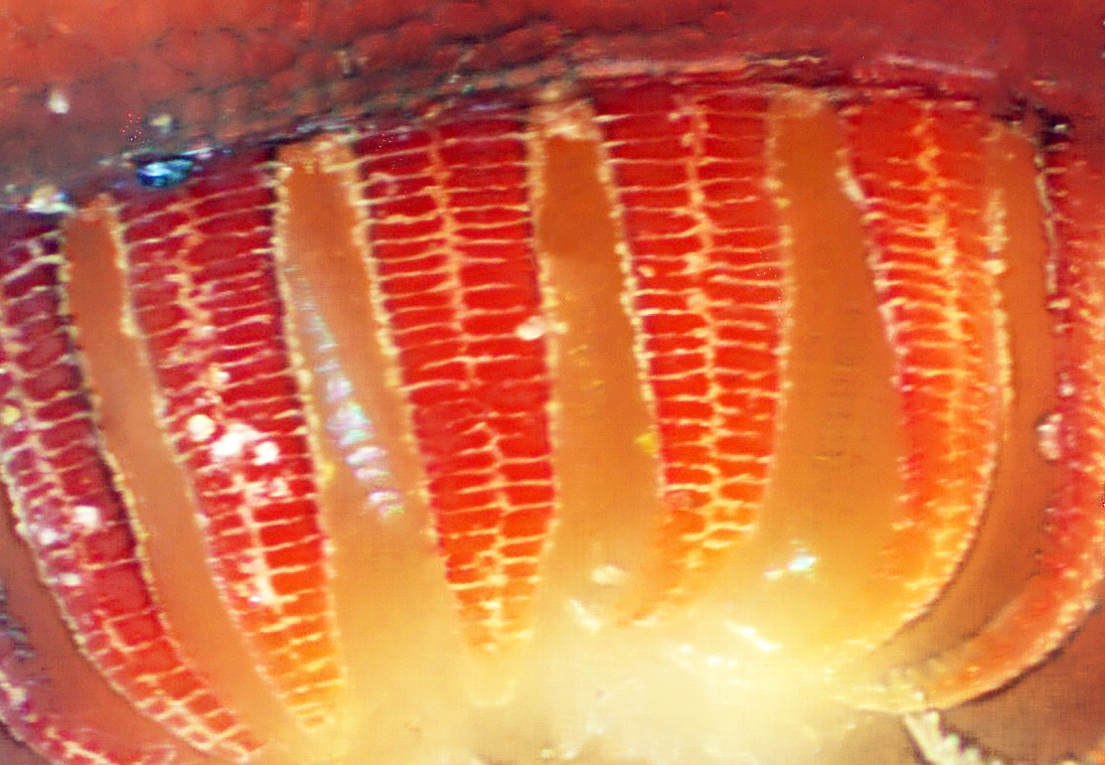
Three types of Peristome in the more typical (peristomate or arthrodontous) mosses…
Nematodontous– whole cells glom together into threadlike teeth,
eg the Polytrichaceae
Haplolepidous– a single peristome made up parts of the inner
two layers of the embryonic three layered peristome tissue,
parts of dead cells but not whole cells
Diplolepidous– a double peristome, made up of parts the outer
two layers of the embryonic three layered peristome tissue,
parts of dead cells but not whole cells
Teeth end up one cell (scale) wide
Teeth end up two cells (scales) wide

Slide 17
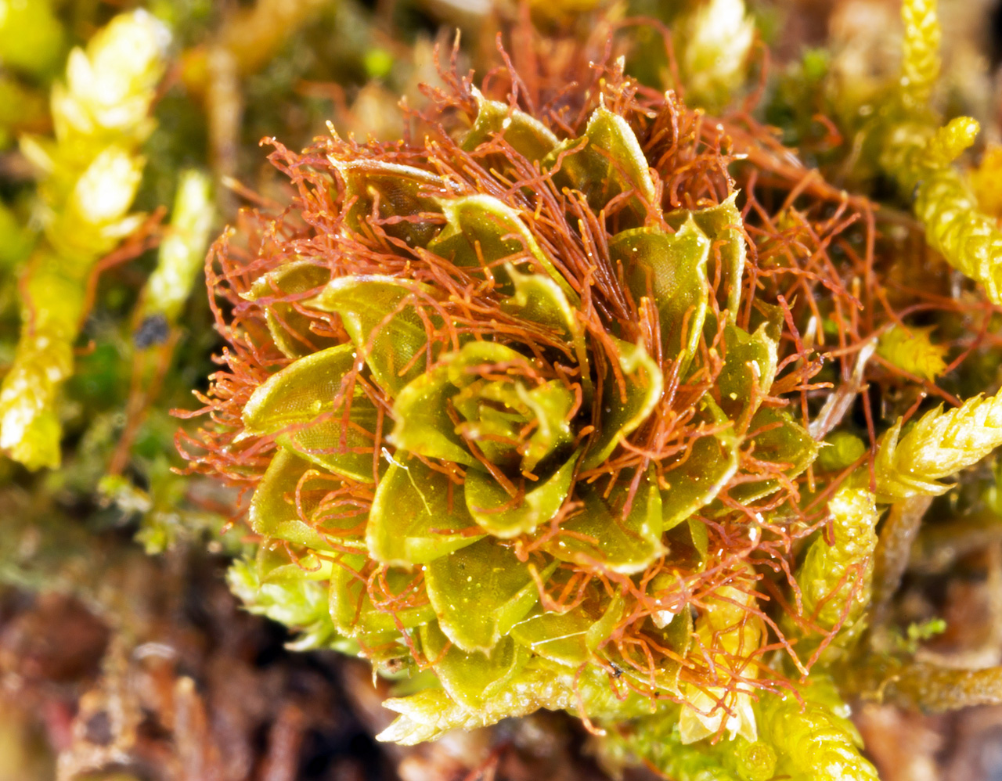
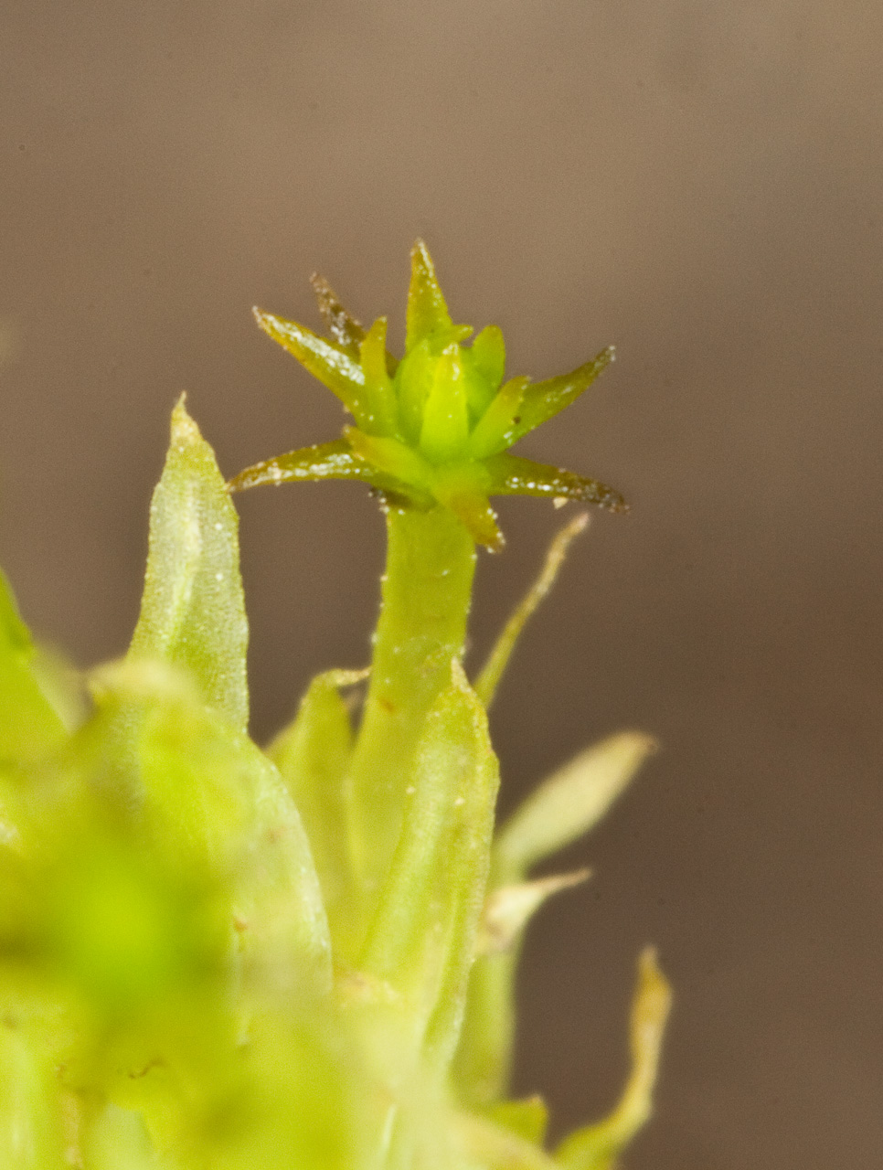
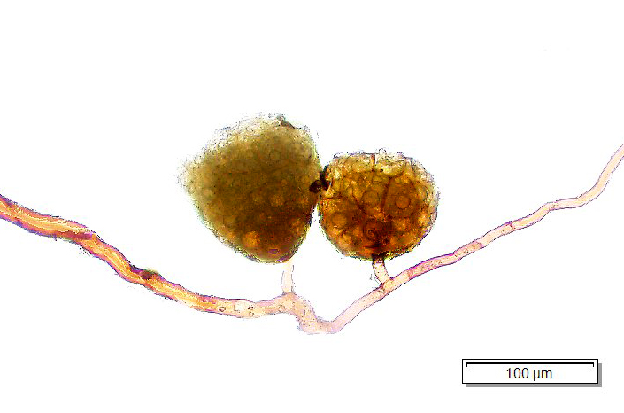
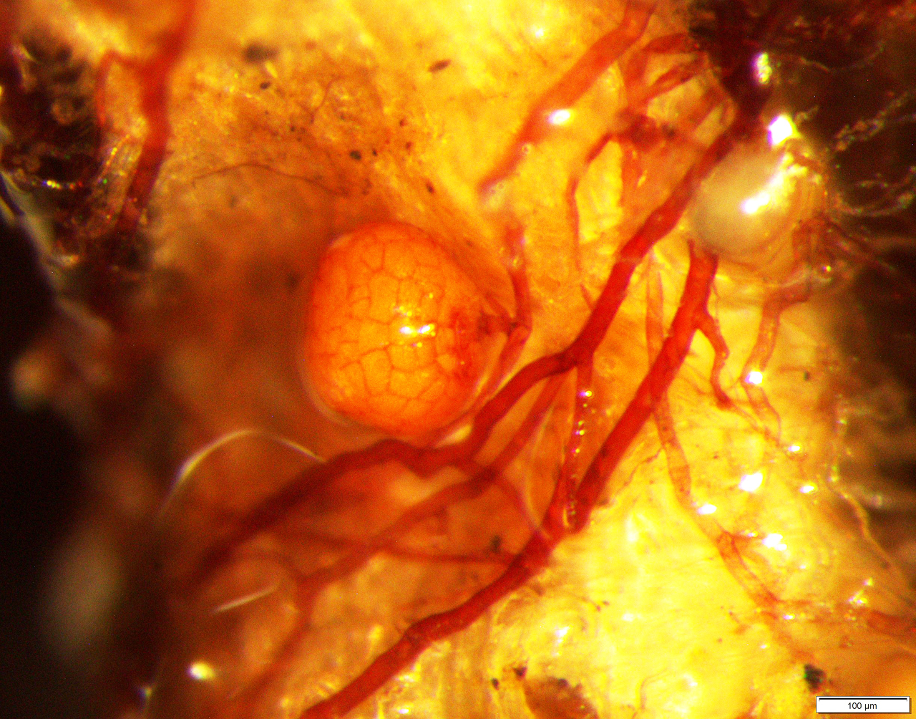
Asexual Reproduction in Mosses
Fragmentation of almost any part of the plant
Gemmae— small asexual reproductive structure that produces a gametophyte
Rhizoidal tubers– gemmae produced by rhizoids

Slide 18
An Easy Distinction by Growth Habit
Acrocarpous Mosses
Pleurocarpous Mosses
Few branches, vertical growth habit, sporophyte born at apex of main shoot
Much branched, sprawling growth habit, sporophyte born on lateral branches

Slide 19
Liverworts
Leafy
Thallous

Slide 20
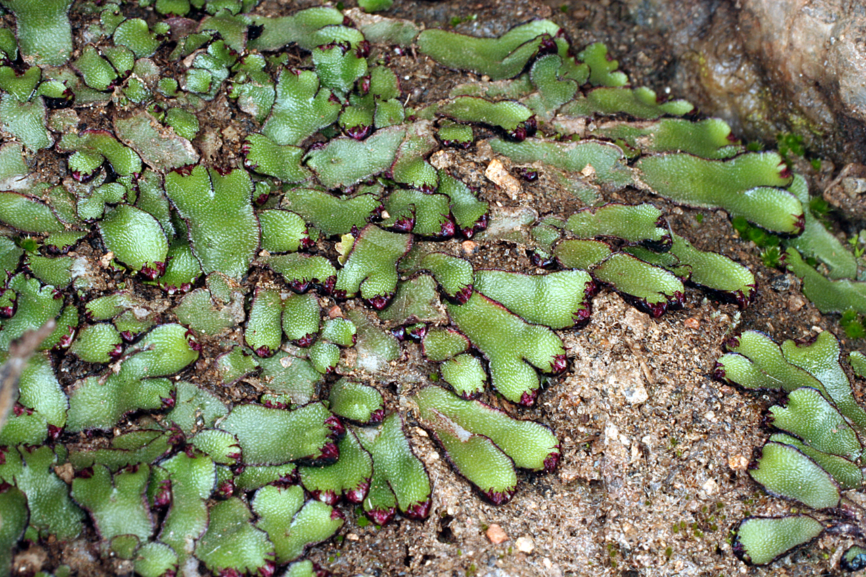
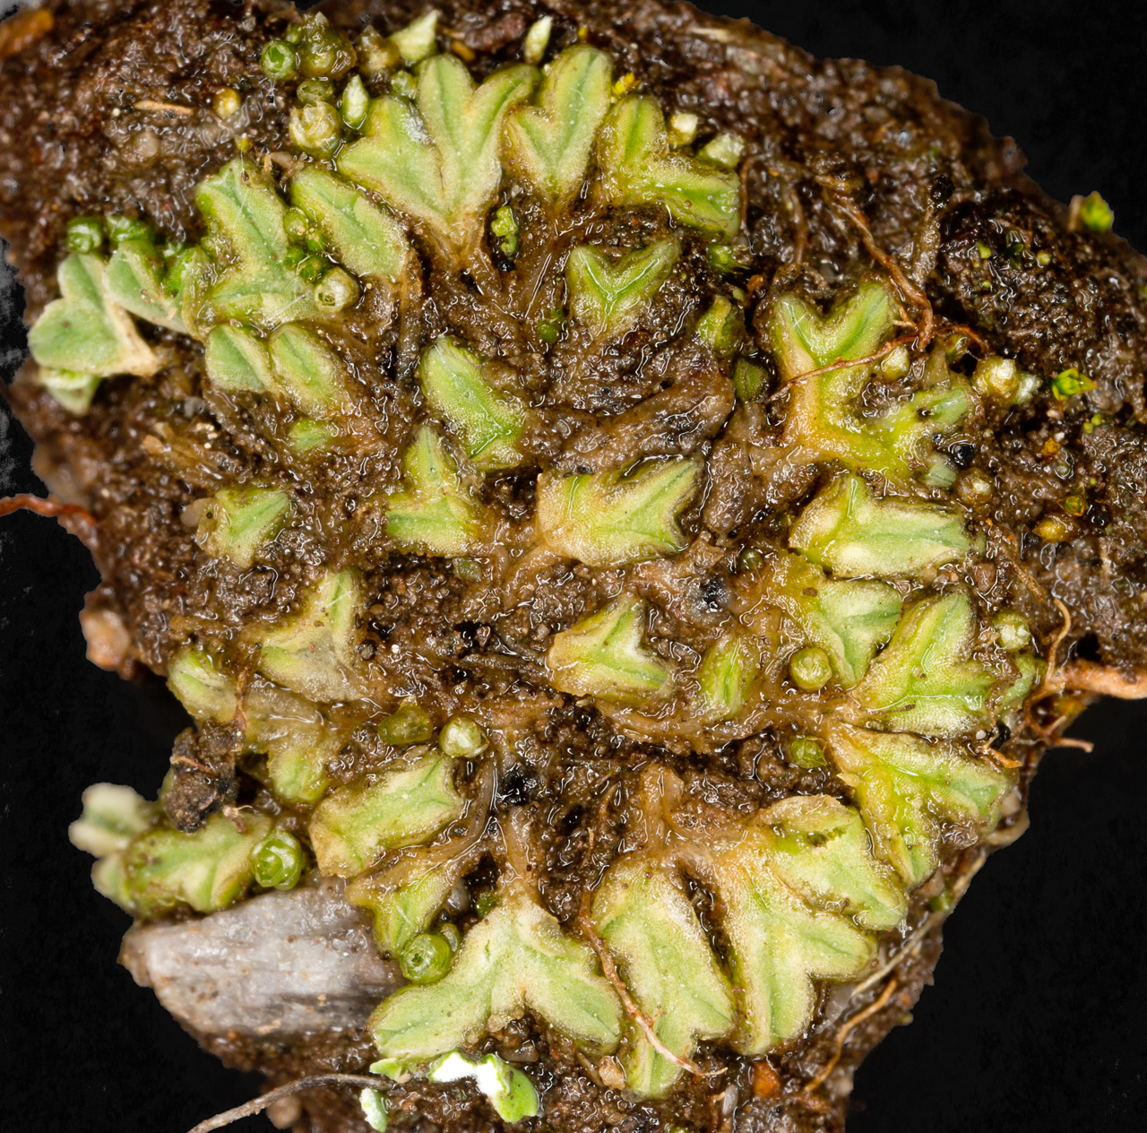
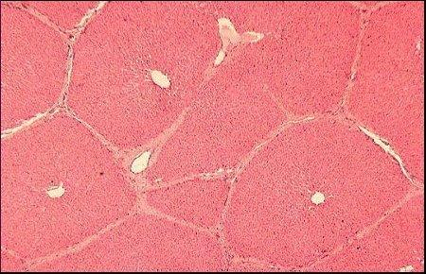
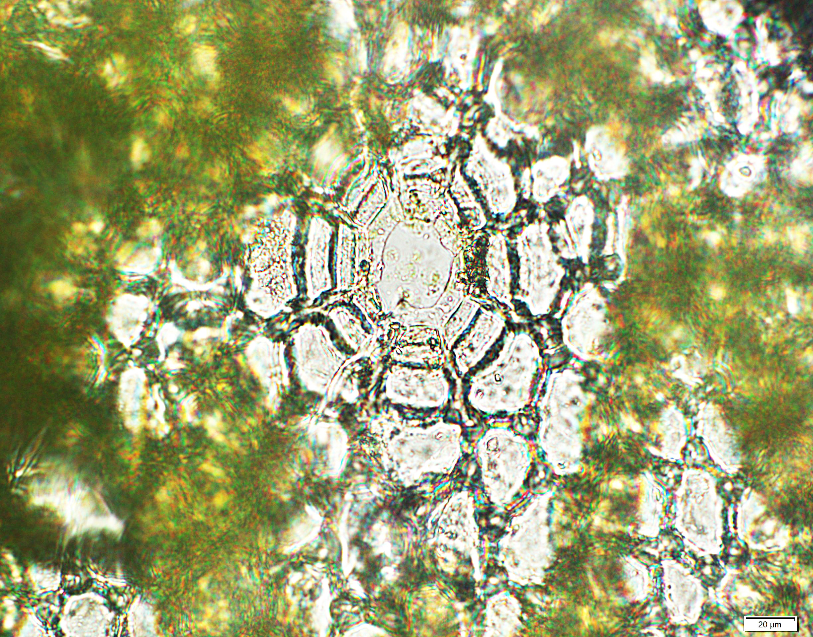
Complex Thallous Liverworts
Vivo.colostate.edu
Surface of thallus
reminiscent of liver
Thallus is comprised
of multiple layers

Slide 21
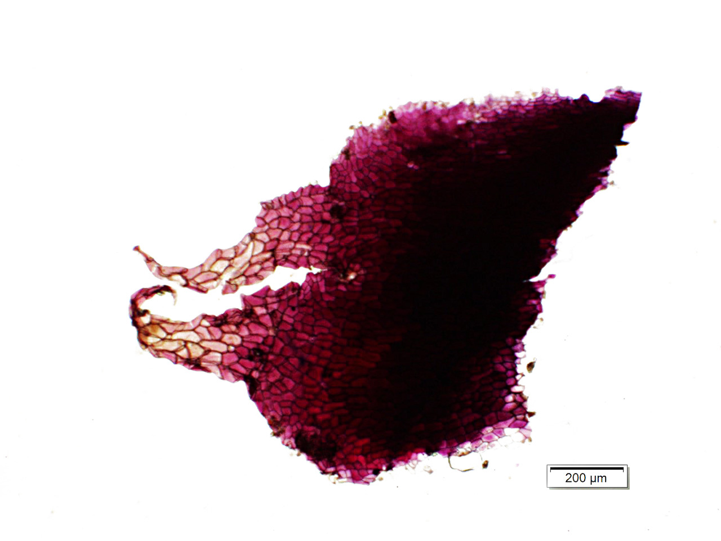
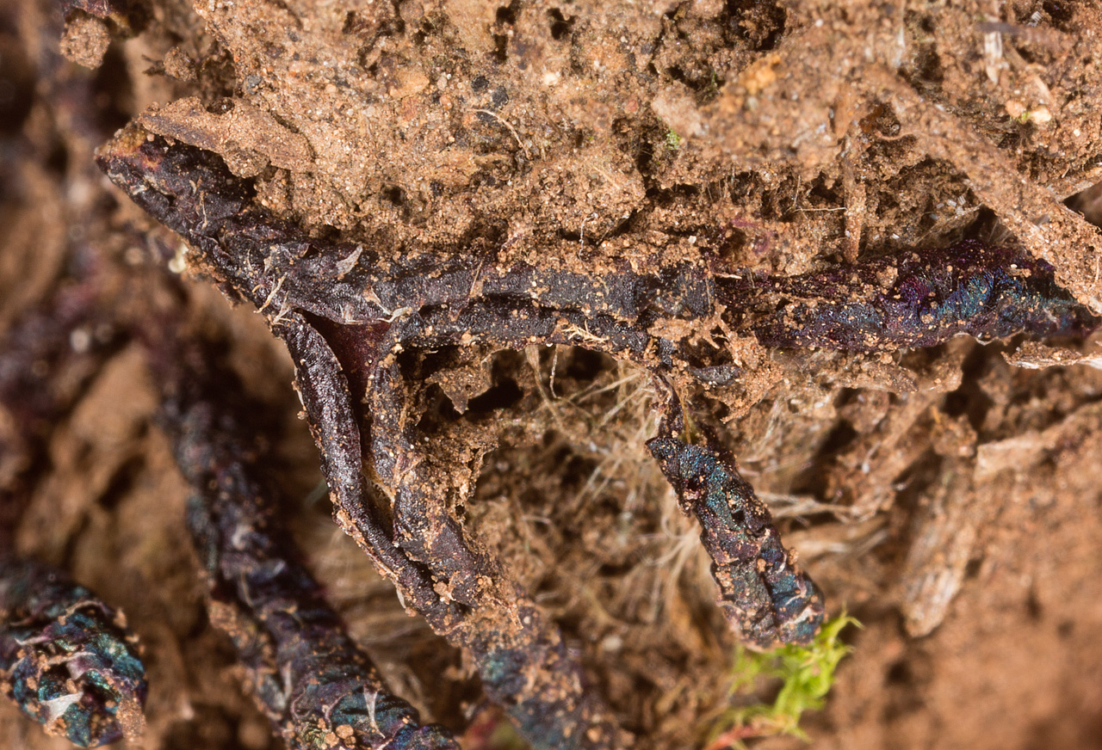
Arid
Adapted
When dry, they
roll up into
black tubes
Ventral surface covered
in dark scales

Slide 22
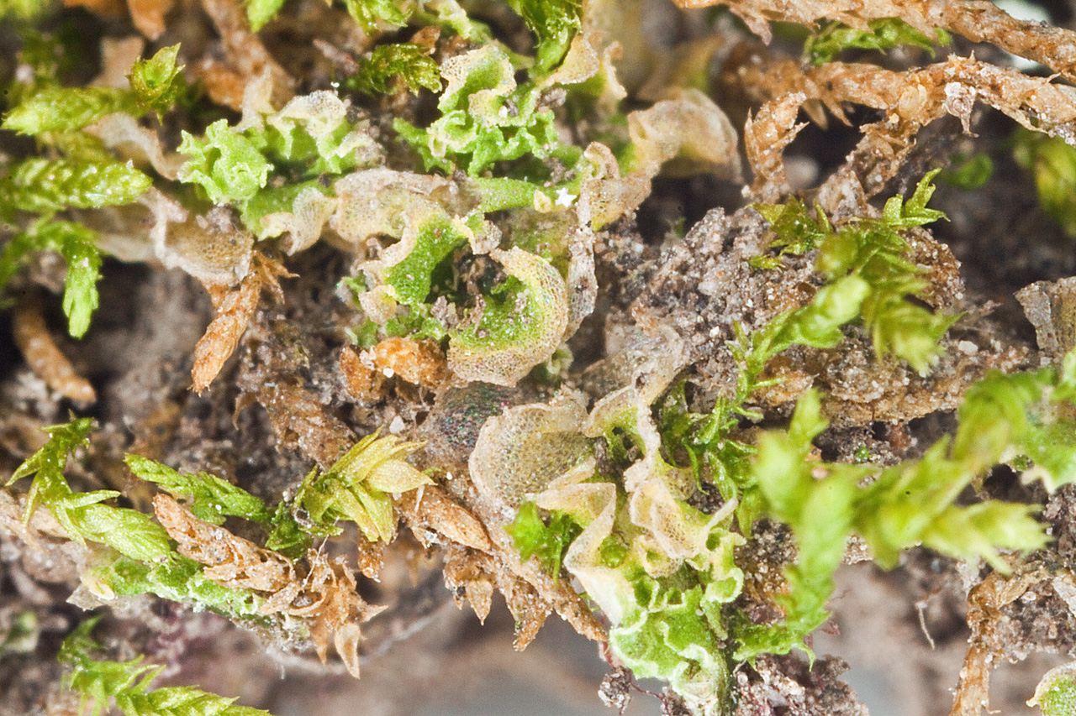
Simple Thallous Liverworts
Thallus is one or
a few cells thick
Much less common
in arid regions

Slide 23
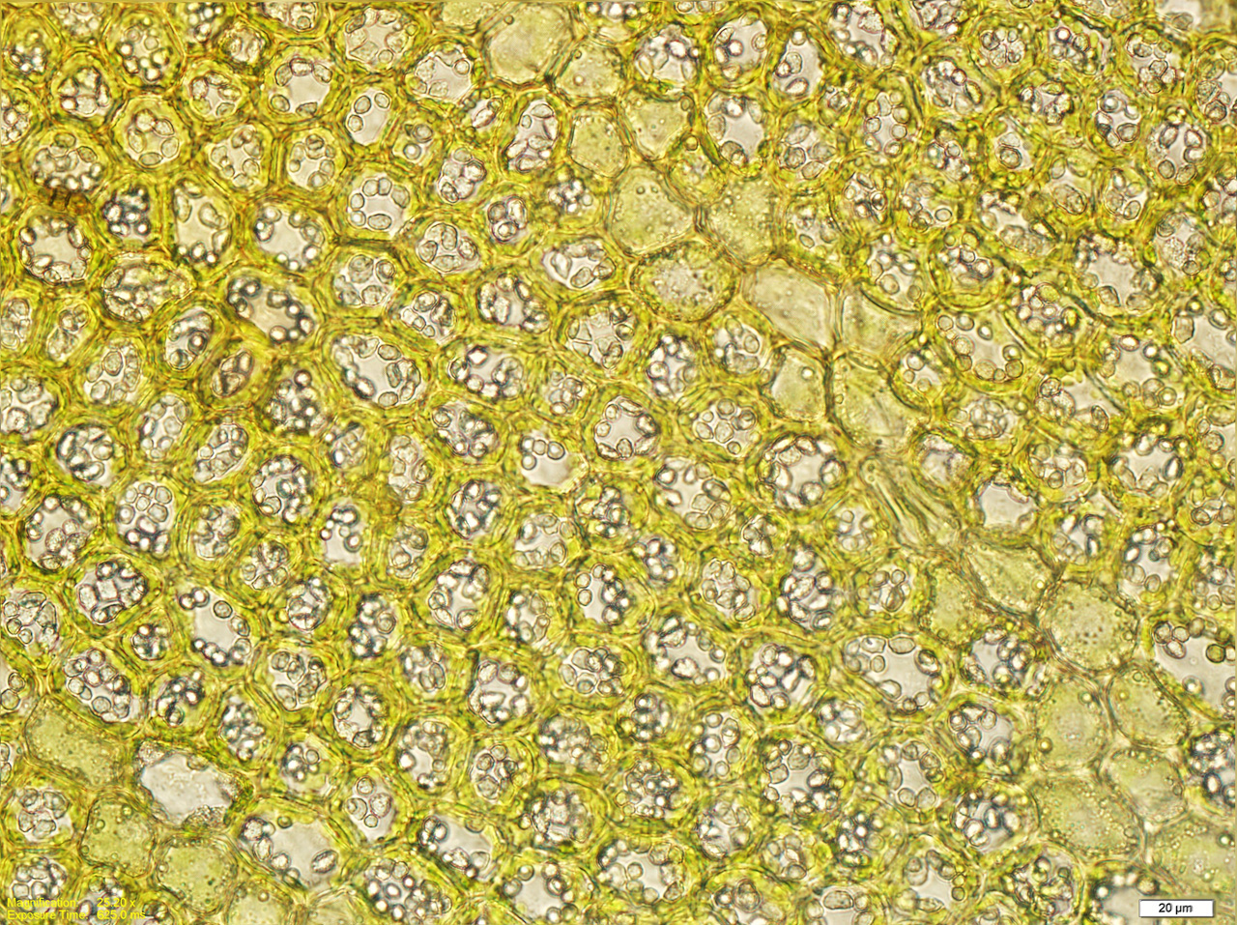
Leafy Liverworts
Can look a lot like mosses, but
No costa
Oilbodies
Two or three rows of leaves essentially in the same plane as the stem;
Moss leaves are usually arranged radially around the stem

Slide 24
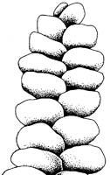
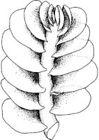
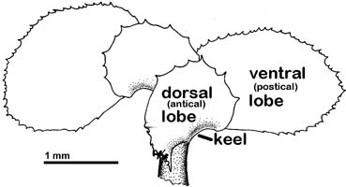
Leafy Liverworts
Incubous
Succubous
Complicate-bilobed
David Wagner, Liverworts of Oregon

Slide 25
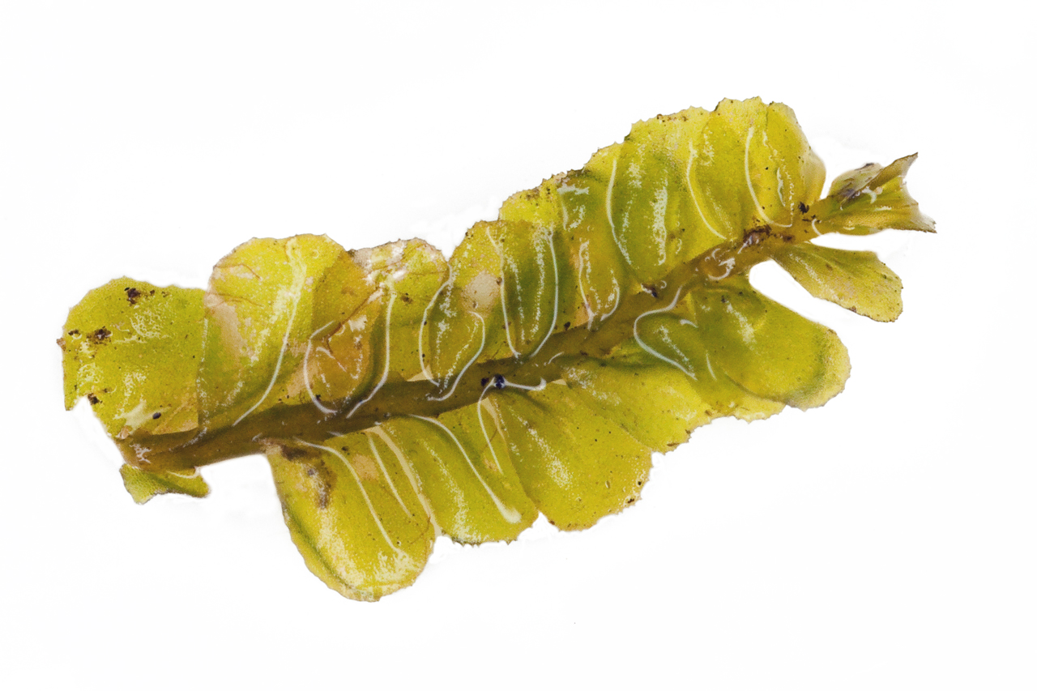
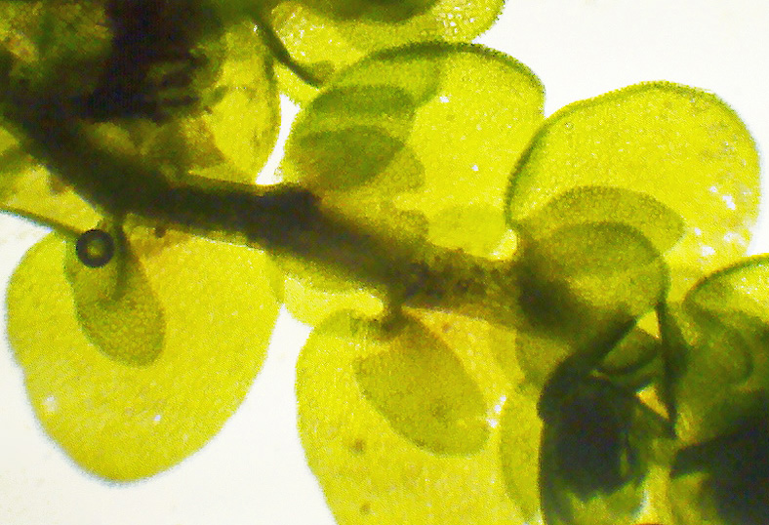
Complicate-bilobed
with Underleaves
Succubous

Slide 26
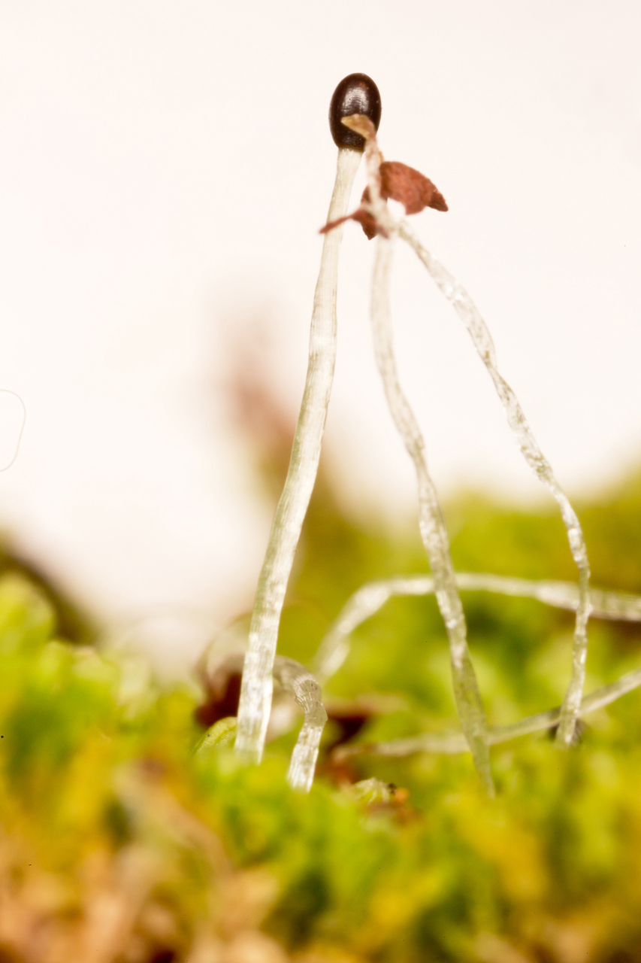
Liverwort Life Cycle
Much the same as in mosses
The actual liverwort plant is a gametophyte
The sporophyte is usually very short-lived

Slide 27
Asexual Reproduction - Gemmae

Slide 28
Hornworts

Slide 29
Be Famous!!
Find a hornwort in New Mexico and become famous!
Thallous gametophyte (no differentiation into stem, leaves)
Synapomorphy-- Sporophyte is persistent, green (photosynthetic) and functional through an entire season
Sporophyte splits from top down to release spores as they mature

Slide 30
Be a Bryologist?
Positive→ know 5 plant ID’s and be a state expert! Almost no bryologists around.
Of course, there’s a reason for that…nearly impossible to make a living as a bryologist…

