Slide 1
Magnoliids
Judd et al pp. 250-262
Previously considered part of “Dicots”

Slide 2
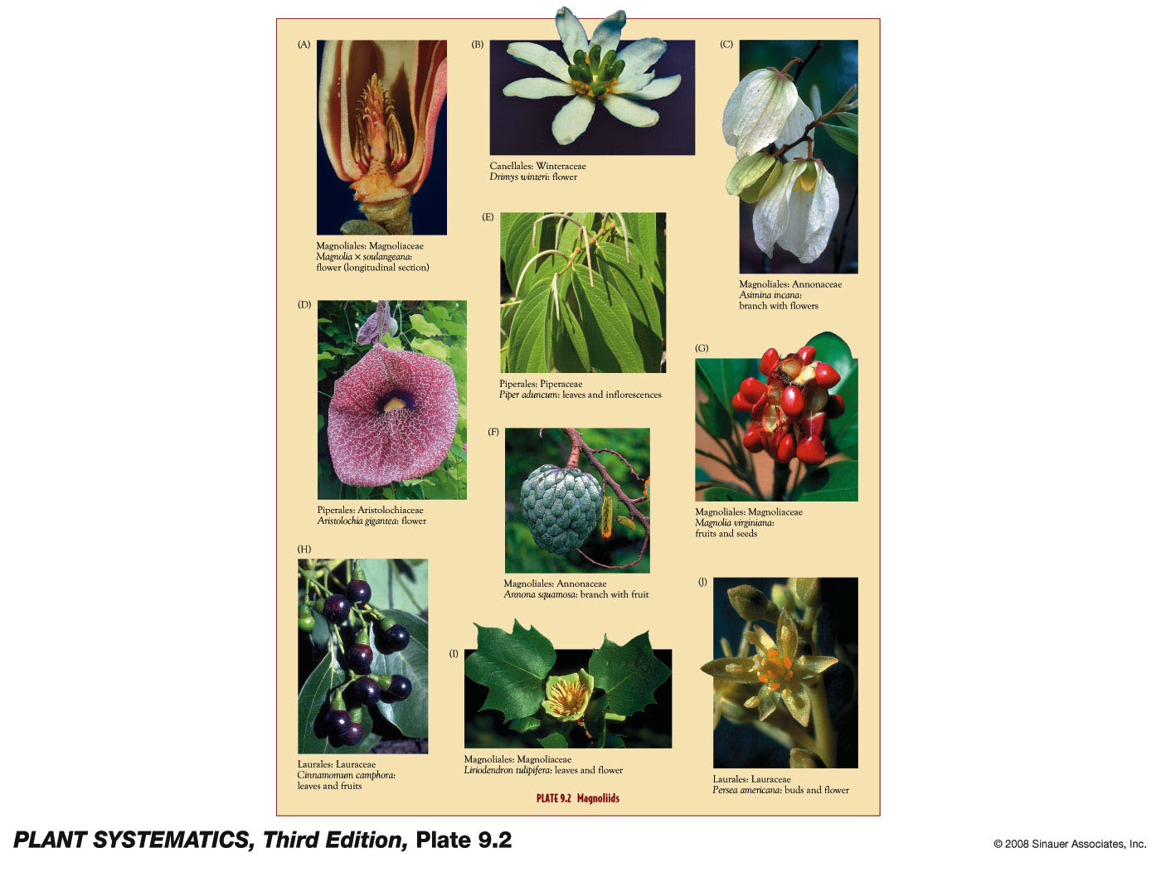

Slide 3
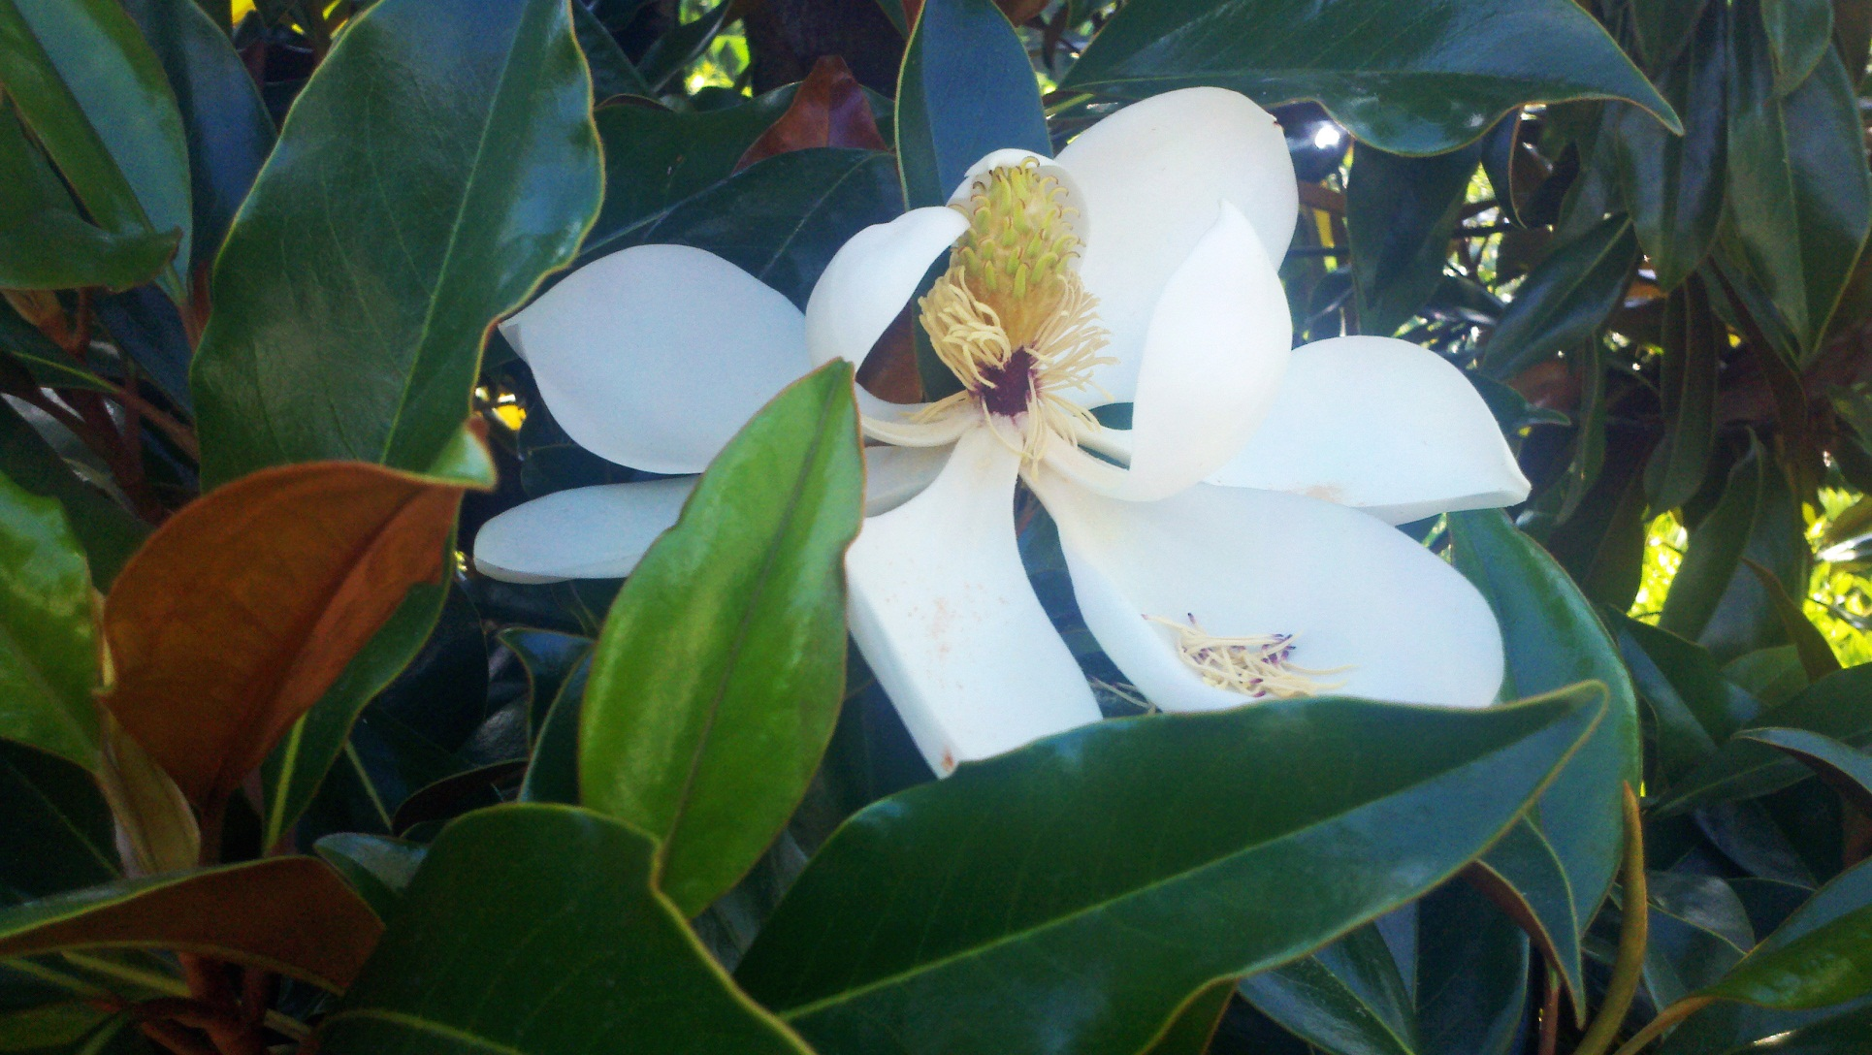
Magnolia “on the Mall!”

Slide 4
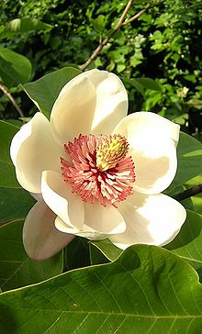
Magnolia on the web

Slide 5
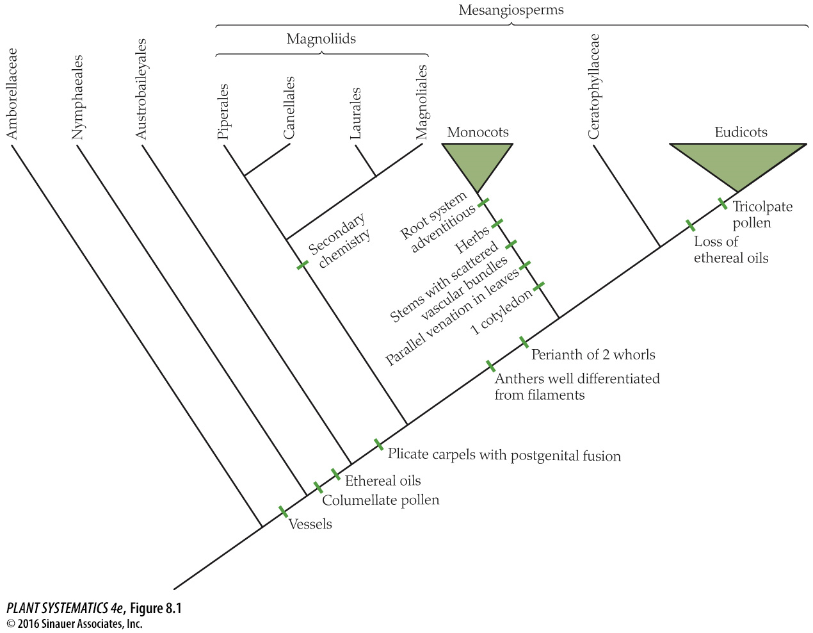
Family of unknown position
You are here!

Slide 6
Magnoliids
Non-monocot, non-eudicot angiosperms
Monophyletic group including the Magnoliales, Laurales, Canellales & Piperales
Perianth parts spiral or whorls of 3, mostly one pore in pollen
Stamens flat or leaf like, filament frequently but not always poorly differentiated from the anther (exception= Piperales)
Morphologically similar to ANA Grade, note that secondary chemistry is given as the best synapomorphy→ many sources of spices!

Slide 7
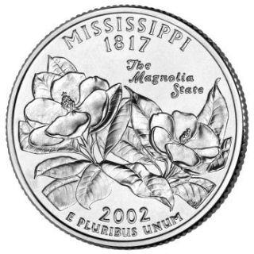
Magnoliales: Magnoliaceae:
2 genera of Magnoliaceae, 220 species

Slide 8
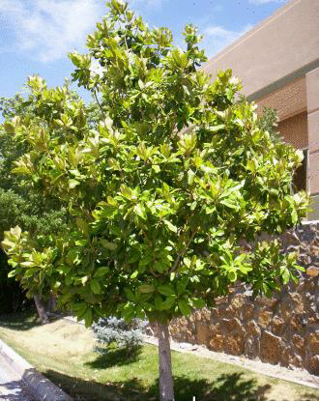
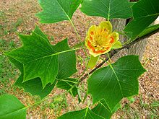
Magnoliaceae
Largest of the 2 genera: Magnolia
– 218 species
Other genus is Liriodendron, only 2 species
(Tulip Tree)

Slide 9
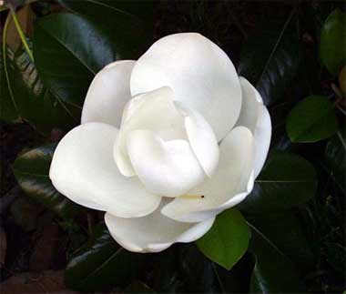
Magnolia grandiflora
Mississippi & Louisiana state flower

Slide 10
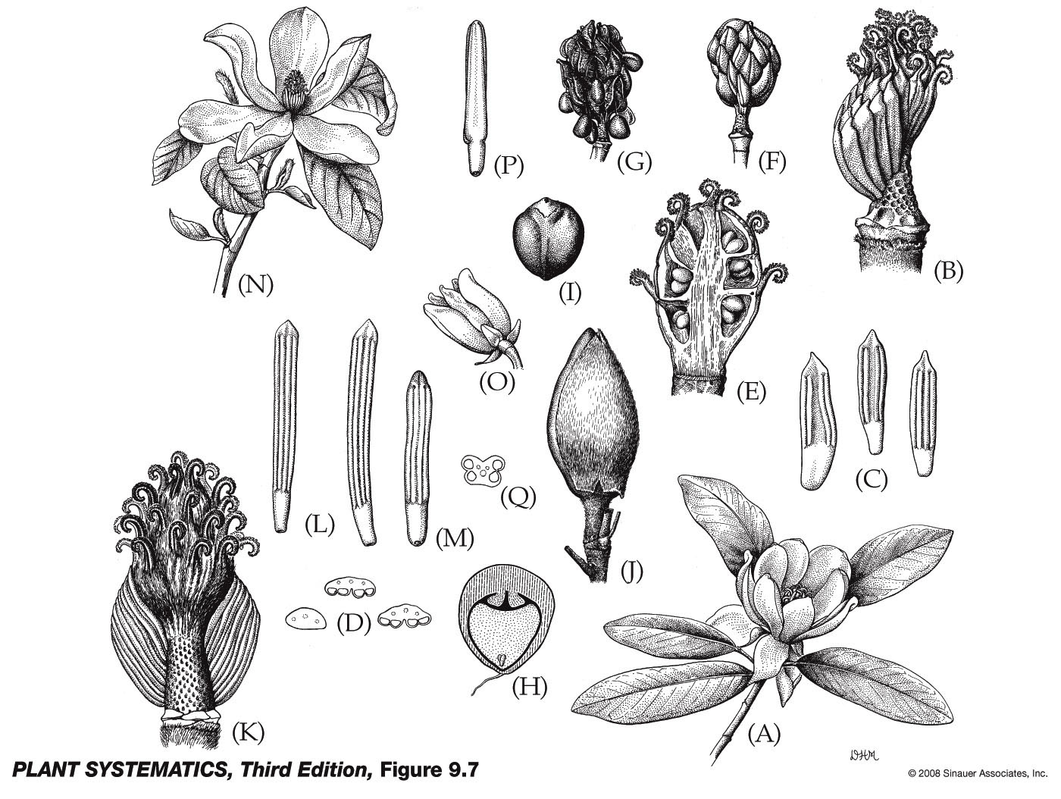
Magnoliales: Magnoliaceae: Magnolia

Slide 11
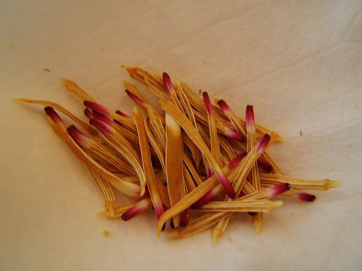
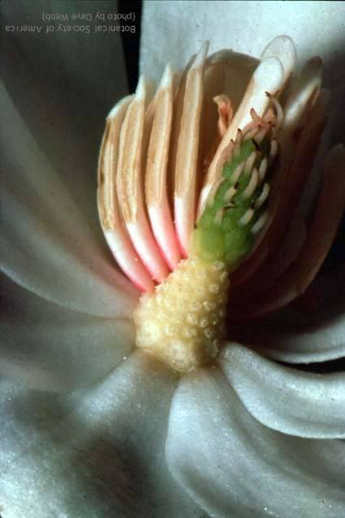
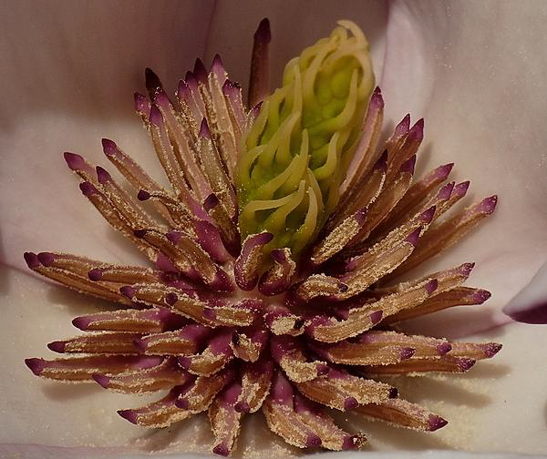
Magnoliales: Magnoliaceae: Magnolia

Slide 12
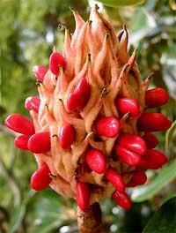
Magnoliales: Magnoliaceae: Magnolia
Fruit– an aggregate of follicles

Slide 13
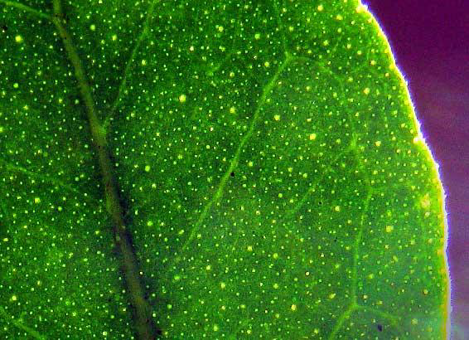
Magnoliaceae: Magnolia— leaf blades with spherical cells (pellucid dots) containing ethereal oils
Umm…this pic is Ptelea trifoliata, a eudicot not a magnoliid! What’s up…..???

Slide 14
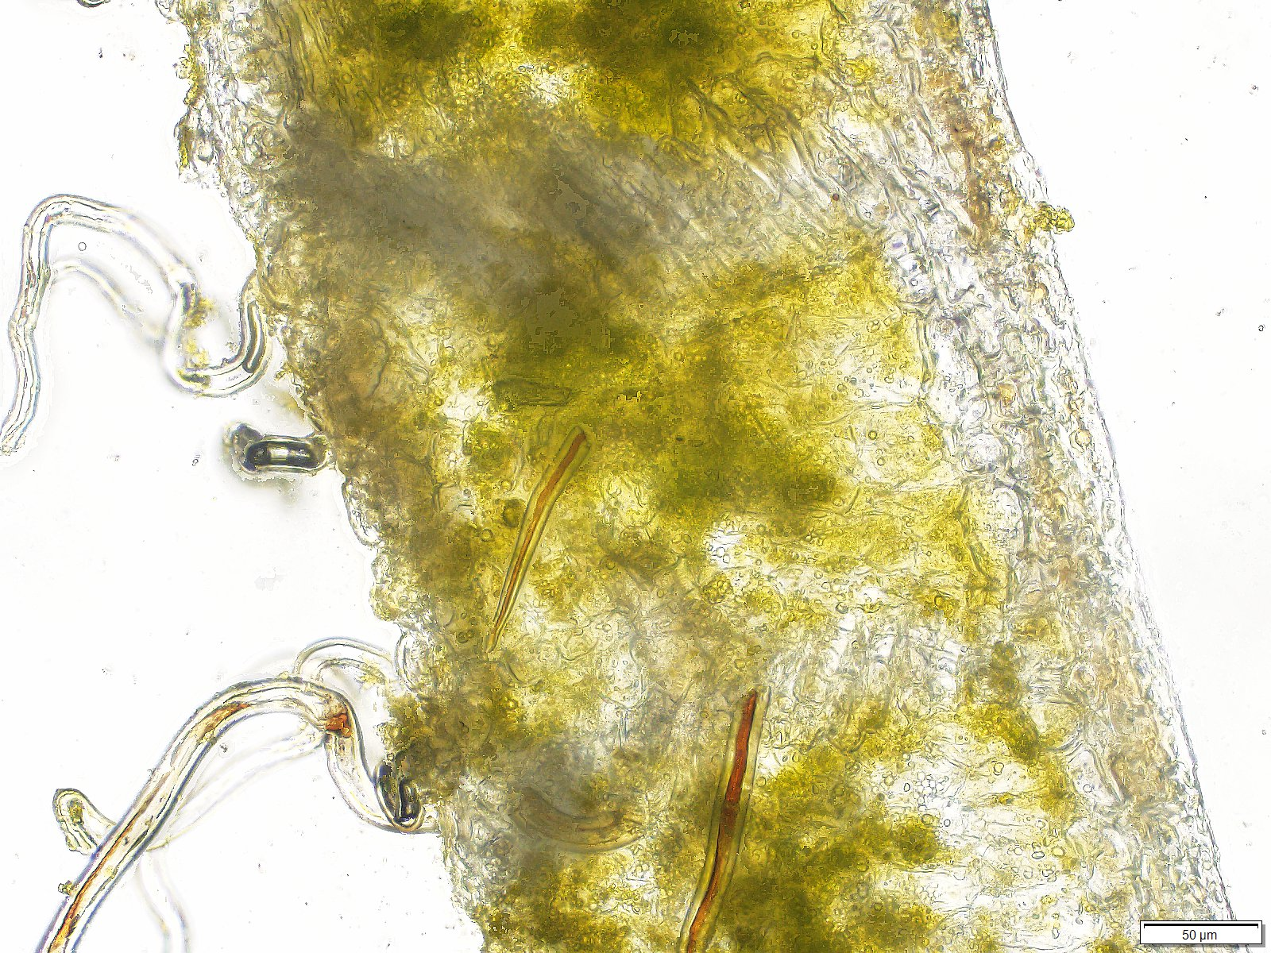
Idioblasts in Magnoliid Leaves
Per discussion with Walter Judd… ethereal oils are in microscopic idioblasts in magnoliids, not the easily visible pellucid dots of the Rutaceae in eudicots

Slide 15
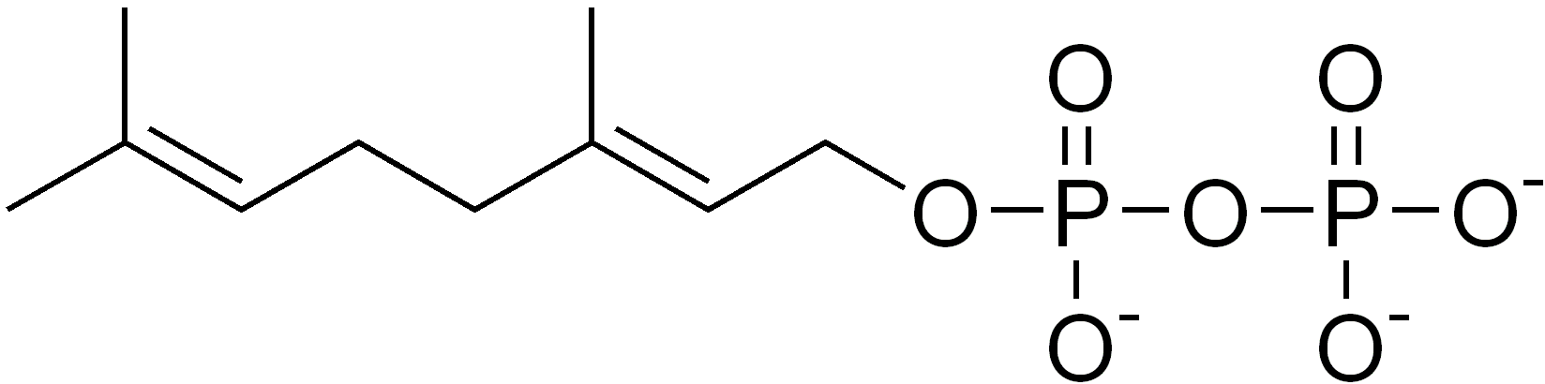
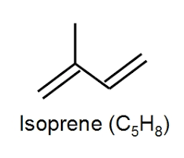
Ethereal Oil
“Aromatic, highly volatile, oily secondary plant products containing monoterpenoids and sesquiterpenoids (and other aromatic compounds), frequently in pellucid dots.” J&C pg. 572
monoterpene

Slide 16
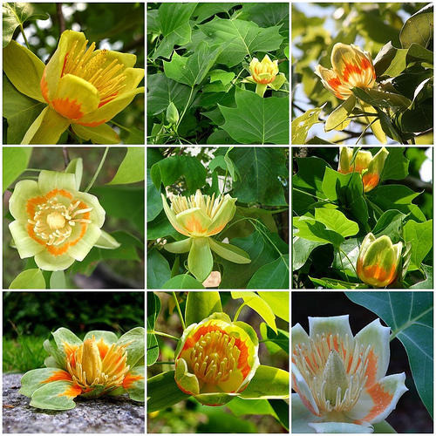
Magnoliales: Magnoliaceae: Liriodendron tulipfera

Slide 17
Magnoliaceae
Foliage-- Trees/shrubs blade with pellucid dots containing ethereal oils (aromatic terpenoids)
Calyx
Corolla
Androecium -- Many undifferentiated stamens
Gynoecium-- Numerous distinct
Fruit– aggregate of follicles, seed red, dangles
Tepals

Slide 18
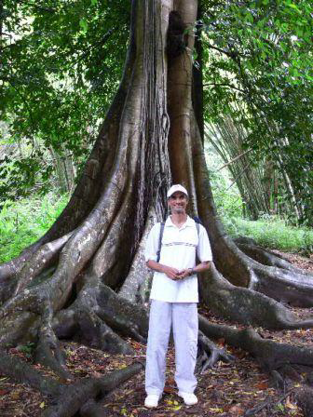
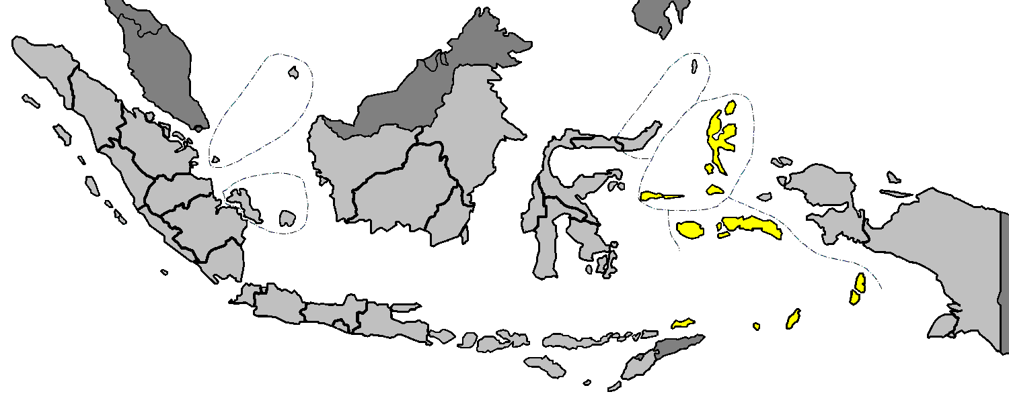
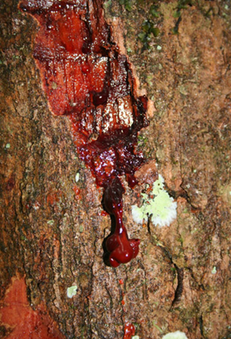
Magnoliales: Myristicaceae
MMy
Myristica: source of nutmeg and mace, from the Spice Islands (Indonesia)
Bark exudes reddish sap when slashed.

Slide 19
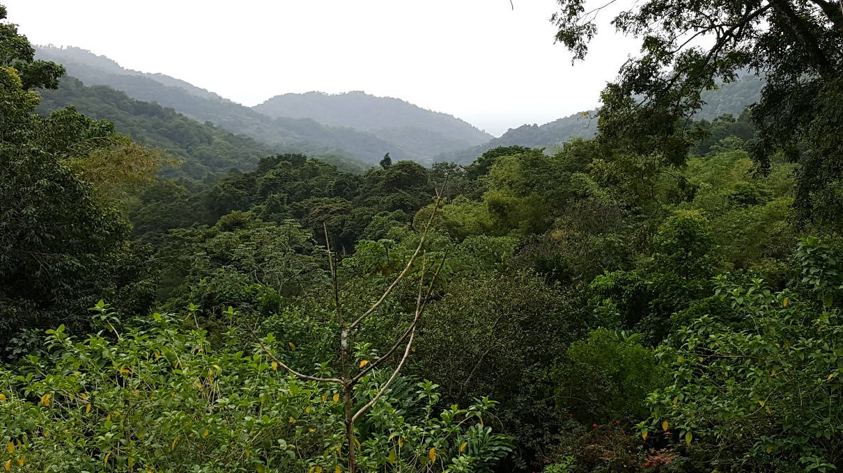
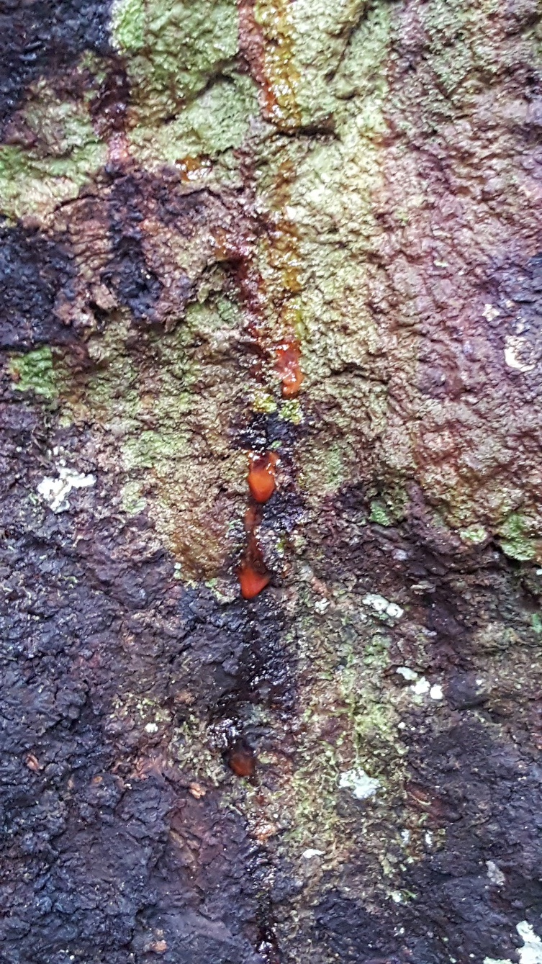
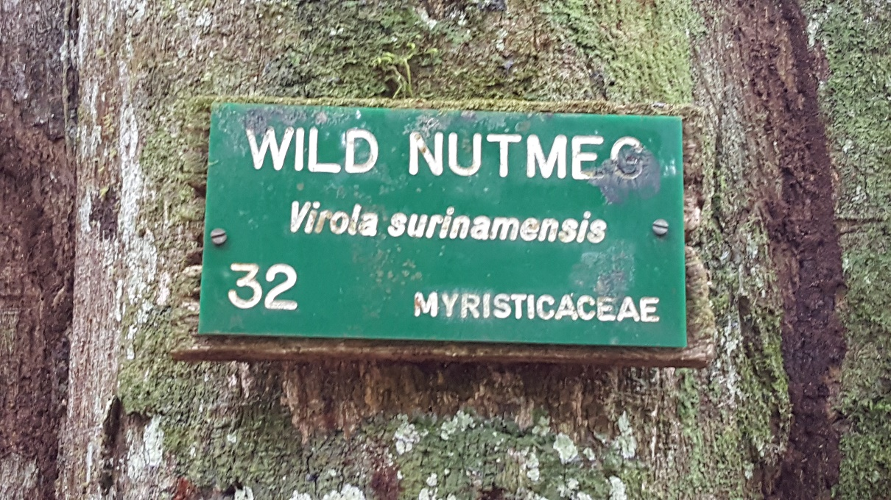
Myristicaceae in South America

Slide 20
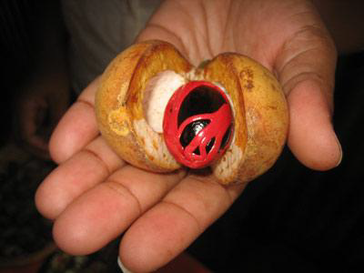
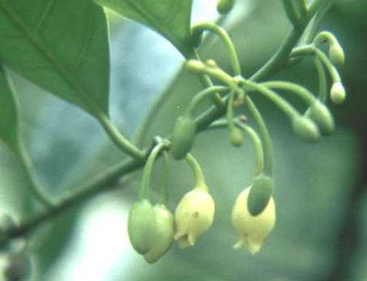
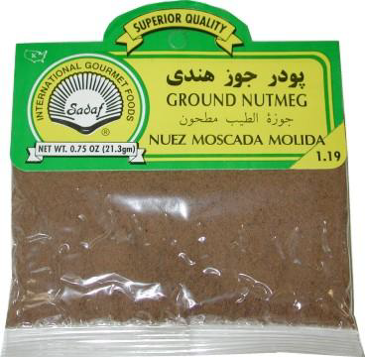
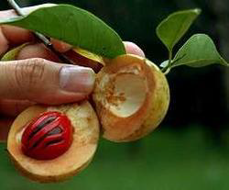
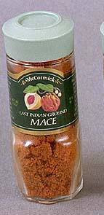
Magnoliales: Myristicaceae: Myristica
Seeds of Myristica fragrans (nutmeg tree) are the source of nutmeg; the colorful aril is the source of the spice called Mace.
Flowers…3 connate tepals

Slide 21
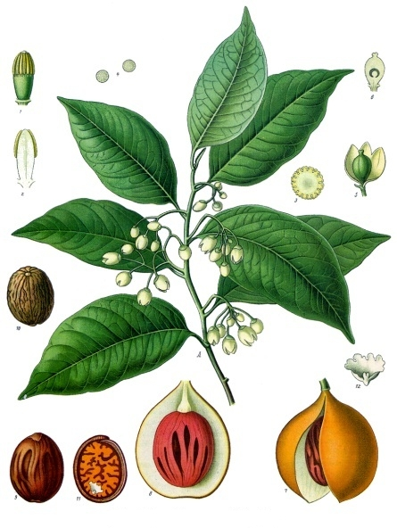
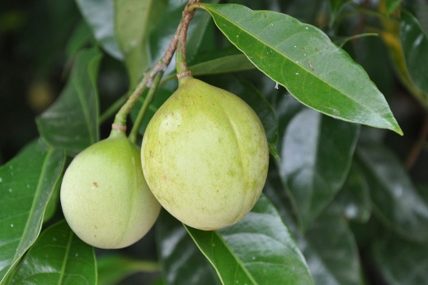
Stamens with filaments connate into solid column
Note one carpel, superior ovary
Monadelphous!
Follicle? Berry? Legume? Capsule? Other?– dehiscent along two sides, fleshy, one carpellate flower

Slide 22
Magnoliales: Myristicaceae
Foliage– bark exudes reddish sap; blades with pellucid dots containing ethereal oils; contains myristicin (=hallucinogen)
Calyx
Corolla
Androecium– filaments connate into a solid column
Gynoecium-- one ovule, ovary superior
Fruit– leathery follicle, large seed, colorful aril
Three connate tepals

Slide 23
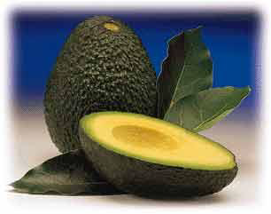
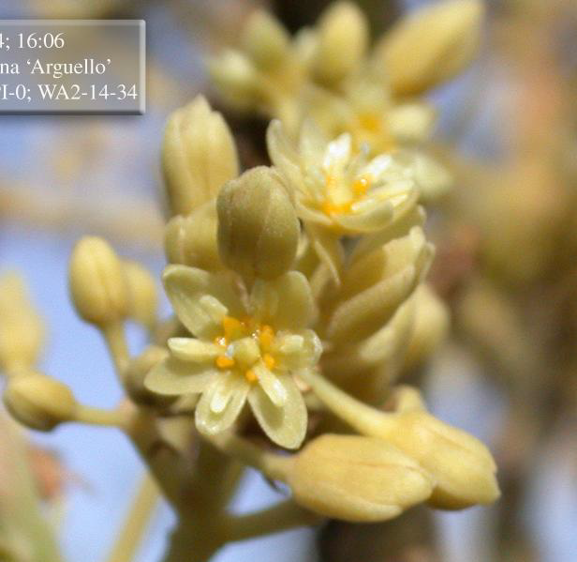
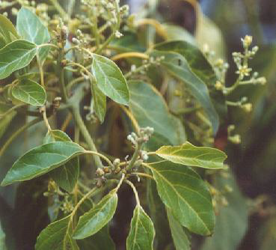
Laurales: Lauraceae
Trees or shrubs including sources for Sassafras, Cinnamon, Avocado, Bay Leaves, etc.
Persea americana
A trees and B trees promote outcrossing

Slide 24
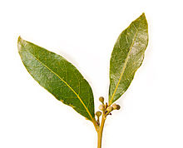
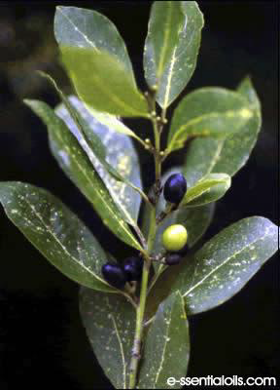
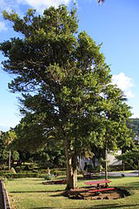
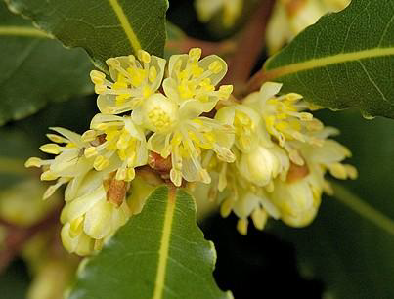
Laurales: Lauraceae: Laurus nobilis
Bay Laurel

Slide 25
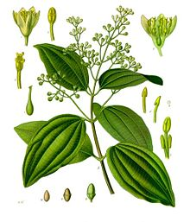
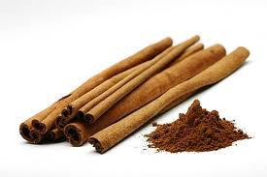
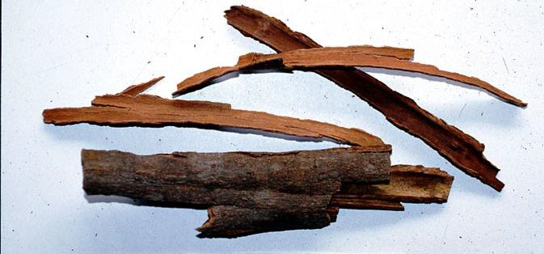
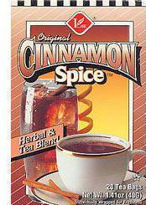
Laurales: Lauraceae: Cinnamomum
Large genus of over 300 species that is source of camphor, cinnamon, etc.
Cinnamomum verum and other species provide the spice.

Slide 26
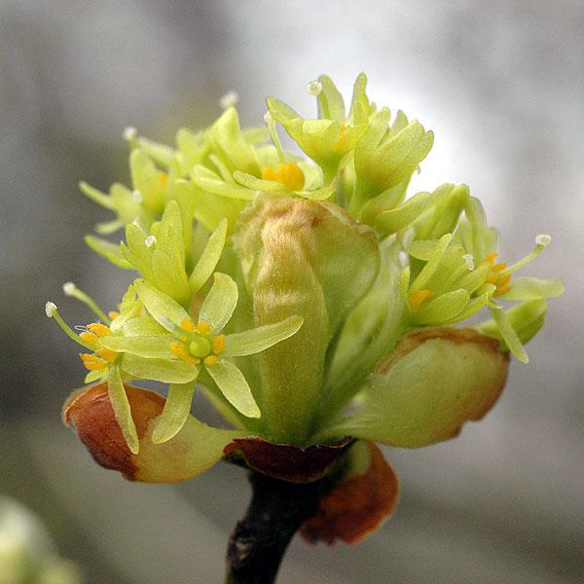
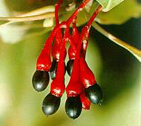
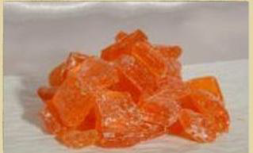
Laurales: Lauraceae: Sassafras
Extract of essential oil is source of perfumes, root beer, candy, and the drug MDMA(ecstasy.)
Sassafras candy
Fruit is a drupe

Slide 27
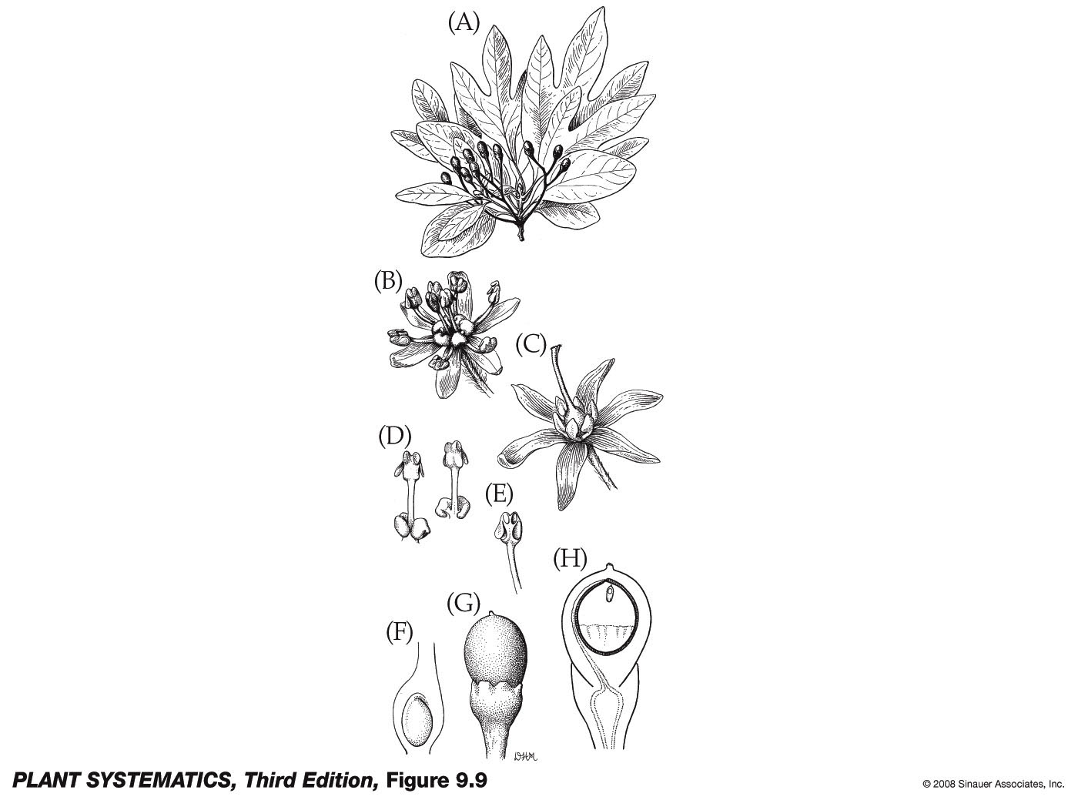
Sassafras albidum
Leaves have pellucid dots
6 tepals
Stamens with nectar producing appendages
One ovule

Slide 28
Laurales: Lauraceae
Foliage– contain ethereal oils
Calyx
Corolla
Androecium— filaments with nectar producing appendages
Gynoecium— one carpel, ovary superior
Fruit– drupe or one seeded berry
Usually 6 tepals

Slide 29
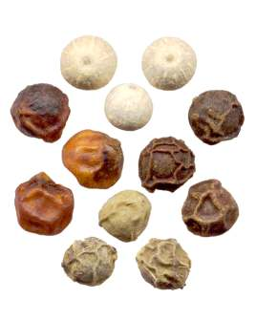
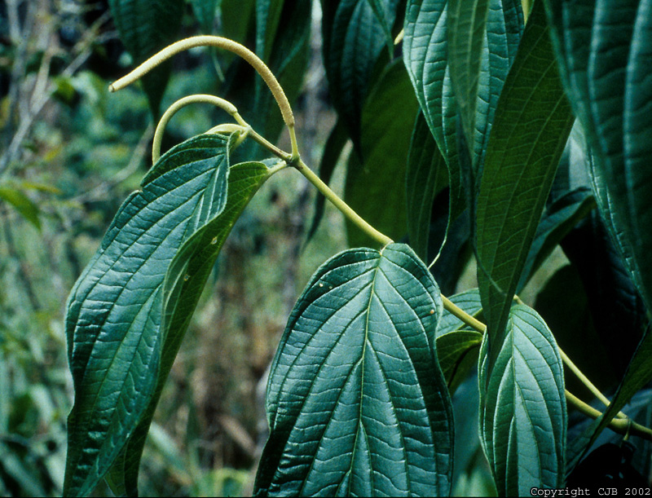
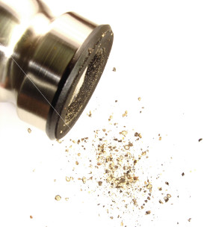
Piperales: Piperaceae: Piper

Slide 30
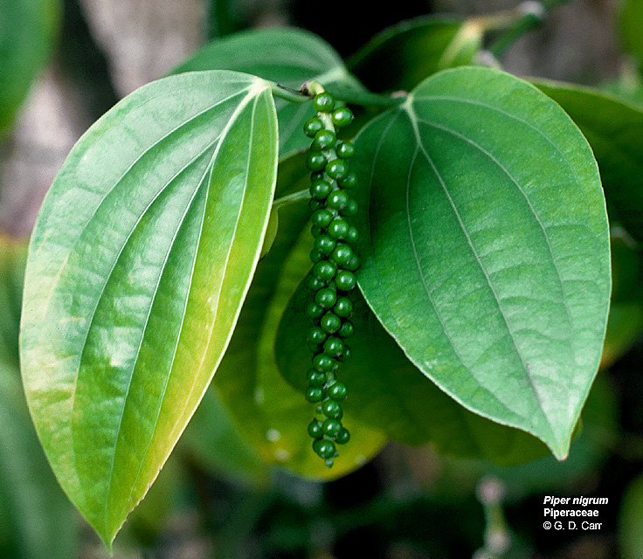

Piperales: Piperaceae: Piper
Piper nigrum

Slide 31


Slide 32
Piperales: Piperaceae
Foliage– contains ethereal oils
Calyx
Corolla
Androecium— filaments distinct
Gynoecium— 1 ovule per gynoecium
Fruit– drupe
No perianth! Spikes of thick, minute flowers

Slide 33



Piperales: Aristolochiaceae: Aristolochia watsonii

Slide 34

Aristolochia californica
Ovary

Slide 35


Slide 36
Piperales: Aristolochiaceae
Foliage– ethereal oils with pellucid dots and aristolochic acids, bitter yellow nitrogenous compounds
Calyx– connate, showy, dull red, mottled
Corolla– missing
Androecium– filaments adnate to style
Gynoecium– inferior ovary, 4-6 connate carpels
Fruit– septicidal capsule

Slide 37

Piperales: Saururaceae: Anemopsis
Anemopsis californica
Yerba mansa

Slide 38

Piperales: Saururaceae: Anemopsis
Petaloid bracts
Style
Many tiny, white flowers
Distinct stamens
Flowers bisexual (perfect) but no petals or sepals
Style

Slide 39


Ethnobotany: Antimicrobial
Apparently mostly made
from the roots:

Slide 40

Petaloid bracts
From: Jepson Manual
Distinct stamens
3-4 carpels united at the base

Slide 41
Piperales: Saururaceae
Foliage– Yes, you guessed it: with ethereal oils
Calyx– Absent!
Corolla– Absent!
Androecium– 3-8 distinct stamens
Gynoecium– 3-4 carpels united at the base
Fruit-- capsule
Flowers with a single petaloid bract

Slide 42

On to the Monocots!
Cyperus esculentus

